Slide 1
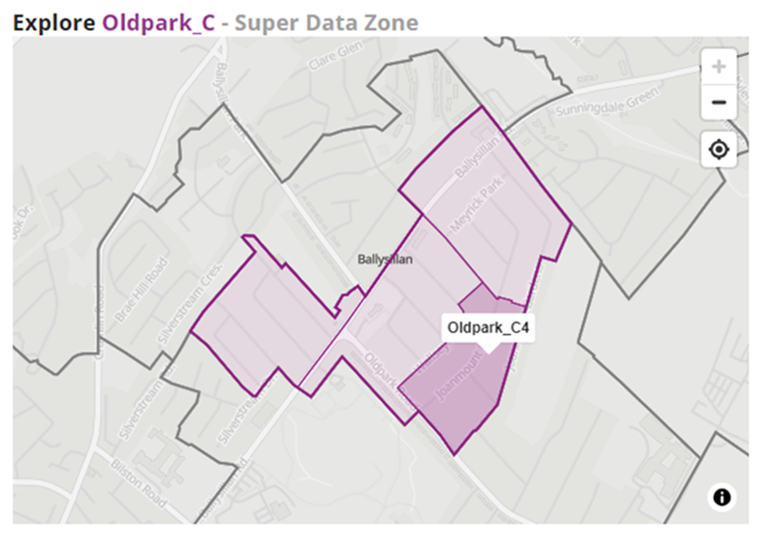
PS - Oldpark_C4
629-633 Oldpark Road, Belfast, Co Antrim, BT14 6QX
Geography Levels:
NI
County – Antrim
LGD - Belfast
District Electoral Area (DEA) - Oldpark
Super Data Zone (SDZ) - Oldpark_C
Data Zone (DZ) – Oldpark_C4
PS

Slide 2
School Pupil Numbers
Source: Schools Plus, Department of Education

Slide 3
School Pupil Numbers by Religion
Source: Schools Plus, Department of Education

Slide 4
Religion – comparison of geographies
Geography levels: NI; County Antrim; LGD – Belfast; DEA – Oldpark; SDZ – Oldpark_C; DZ – Oldpark_C4
Source: NISRA, Census 2021

Slide 5
Religion – comparison of geographies (‘Protestant’ and ‘Other Christian’ categories)
Geography levels: NI; County Antrim; LGD – Belfast; DEA – Oldpark; SDZ – Oldpark_C; DZ – Oldpark_C4
Source: NISRA, Census 2021

Slide 6
Religion (Data Zone for PS) – Oldpark_C4 N=390 people
Data Zone (DZ) = Oldpark_C4
Source: NISRA, Census 2021

Slide 7
Religion – Data Zones on statistical geography boundary of Oldpark_C4. Includes Oldpark_C1, C2, E4, and E1.
Oldpark_C2
C4
Oldpark_E1
Oldpark_E4
PS

Slide 8
Religion – Profiles of DZ Oldpark_C4 compared to boundary DZs of Oldpark_C2, E4, E1, and C1
Source: NISRA, Census 2021

Slide 9
Comparison – DZ + DZs in surrounding area (ie those DZs bordering the School DZ Oldpark_C4)

Slide 10
School Age Population – comparison of geographies
Geography levels: NI; County Antrim; LGD – Belfast; DEA – Oldpark; SDZ – Oldpark_C; DZ – Oldpark_C4
Source: NISRA, Census 2021

Slide 11
School Age Population (Data Zone for school: Oldpark_C4) – N=390 people
Source: NISRA, Census 2021

Slide 12
School Age Population – Data Zones on statistical geography boundary of Oldpark_C4. Includes Oldpark_C1, C2, E4, and E1.
Oldpark_C2
C4
Oldpark_E1
Oldpark_E4
PS

Slide 13
School Age Population – Profiles of DZ Oldpark_C4 compared to boundary DZs of Oldpark_C2, E4, E1, and C1
Source: NISRA, Census 2021

Slide 14
Comparison – DZ + DZs in surrounding area (ie those DZs bordering the School DZ Oldpark_C4)

Slide 15
Distance to School
Source: Department of Infrastructure, School Statistics (2021/22)

