Slide 1
HS - Rowallane_A2
21 Comber Road, Saintfield, Co Down, BT24 7BB
Geography Levels:
NI
County – Down
LGD – Newry, Mourne and Down
District Electoral Area (DEA) - Rowallane
Super Data Zone (SDZ) – Rowallane_A
Data Zone (DZ) – Rowallane_A2
HS

Slide 2
School Pupil Numbers
Source: Schools Plus, Department of Education

Slide 3
School Pupil Numbers by Religion
Source: Schools Plus, Department of Education

Slide 4
Religion – comparison of geographies
Geography levels: NI; County Down; LGD – Newry, Mourne, and Down ; DEA – Rowallane; SDZ – Rowallane_A; DZ – Rowallane_A2
Source: NISRA, Census 2021

Slide 5
Religion – comparison of geographies (‘Protestant’ and ‘Other Christian’ categories)
Geography levels: NI; County Down; LGD – Newry, Mourne, and Down; DEA – Rowallane; SDZ – Rowallane_A; DZ – Rowallane_A2
Source: NISRA, Census 2021

Slide 6
Religion (Data Zone for School) – Rowallane_A2 N=758 people
Data Zone (DZ) = Rowallane_A2
Source: NISRA, Census 2021

Slide 7
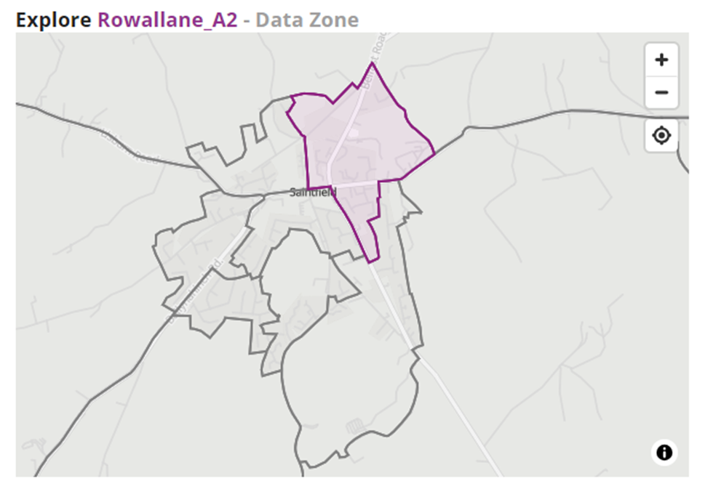
Religion – Urban (mean population density = 22.9/ha) (Data Zones ≤0.5mile to the west of Rowallane_A2. Includes Rowallane_A1, A3, B1, B2, B3, and B4.)
A1
Rowallane_A2
A3
A3
B1
Oldpark_C2
B2
B3
C4
B4
Oldpark_E4
School

Slide 8
Religion – Profiles of DZ Rowallane_A2 compared to urban DZs of Rowallane_A1, A3, B2, B1, B3, B4)
Source: NISRA, Census 2021

Slide 9
Comparison – School community, School DZ, and DZs in surrounding urban area of School DZ Rowallane_A2)
School Community
Local Community
School

Slide 10
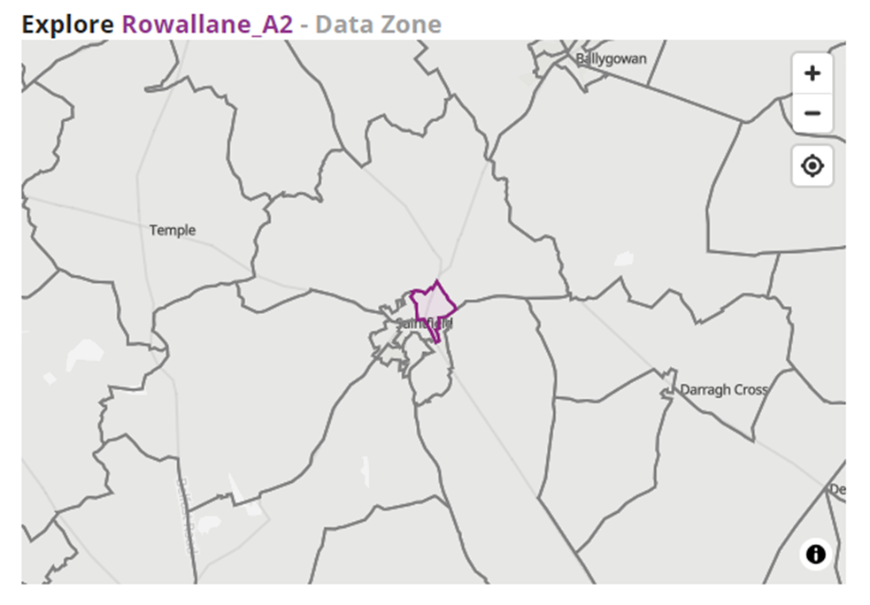
Religion – Rural (mean population density = 0.4/ha) (Data Zones of surrounding rural area, within approx. 5-mile of Rowallane_A2. Includes Rowallane_C1, C2, C3, and E4.)
C1
A2
C2
E4
C3

Slide 11
Religion – Profiles of DZ Rowallane_A2 compared to boundary DZs of Rowallane_A2, C1, C2, C3, and E4
Source: NISRA, Census 2021

Slide 12
Comparison – School community, School DZ, and DZs in surrounding rural area of School DZ Rowallane_A2)
School Community
Local Community
School

Slide 13
Comparison – School community, School DZ, and DZs in surrounding urban/rural area of School DZ Rowallane_A2)
School Community
Local Community
School

Slide 14
Distance to School
Source: Department of Infrastructure, School Statistics (2021/22)

