Slide 1
PROTOCOL: NI (highest), County, LGD, Data Zone (lowest) geography levels
Northern Ireland
County = Londonderry
LGD = Derry City and Strabane
Super Data Zone = Waterside_C
Data Zone = Waterside_C5
School
Source: NISRA Flexible Table Builder, Census 2021

Slide 2
Super Data Zone – Waterside_C (N=2533)
School

Slide 3
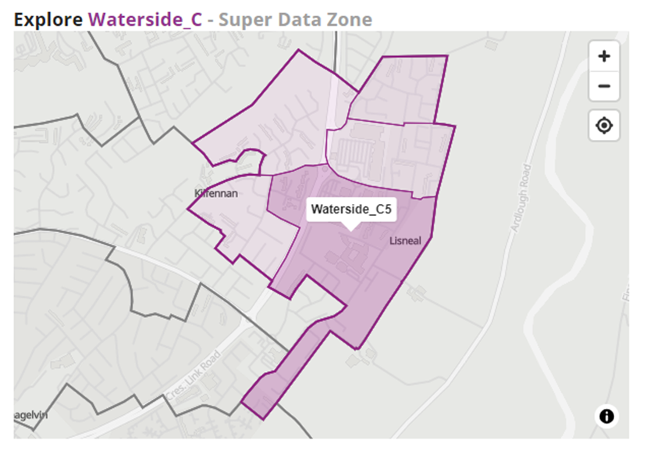
Data Zone – Waterside_C5 (N=630)
School

Slide 4
School Age Population

Slide 5
Age Profile

Slide 6
Parent Qualifications

Slide 7
National Identity

Slide 8
Religion or Religion Brought Up In

Slide 9
Socio-Economic Categorisation (SEC)

Slide 10
Employment History

Slide 11
English Language Proficiency

Slide 12
Health Condition (Emotional or Mental Health)

Slide 13
Household Tenure

Slide 14
Industry

Slide 15
Religion

