Slide 1
Using technology to present a problem solving activity Session 3
Notes:
Recap on yesterday’s learning and what we want to do today

Slide 2
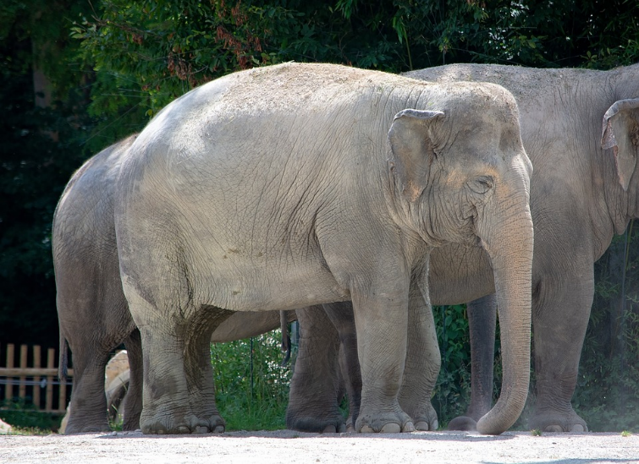
Mind reading
1 x 9 = 9
2 x 9 = 18
3 x 9 = 27
4 x 9 = 36
5 x 9 = 45
6 x 9 = 54
7 x 9 = 63
8 x 9 = 72
9 x 9 = 81

Slide 3
Problem posing
“The formulation of a problem is often more essential than its solution, which may be merely a matter of mathematical or experimental skill. To raise new questions, a new possibility, to regard old problems from a new angle, requires creative imagination and marks real advances in sciences.”
(Einstein & Infeld, 1938).

Slide 4
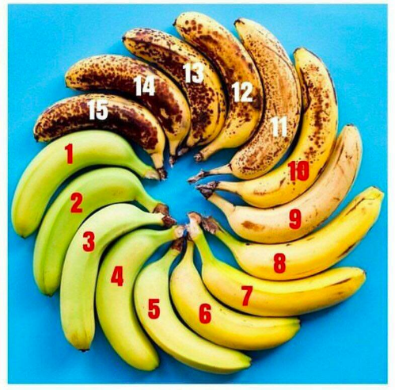
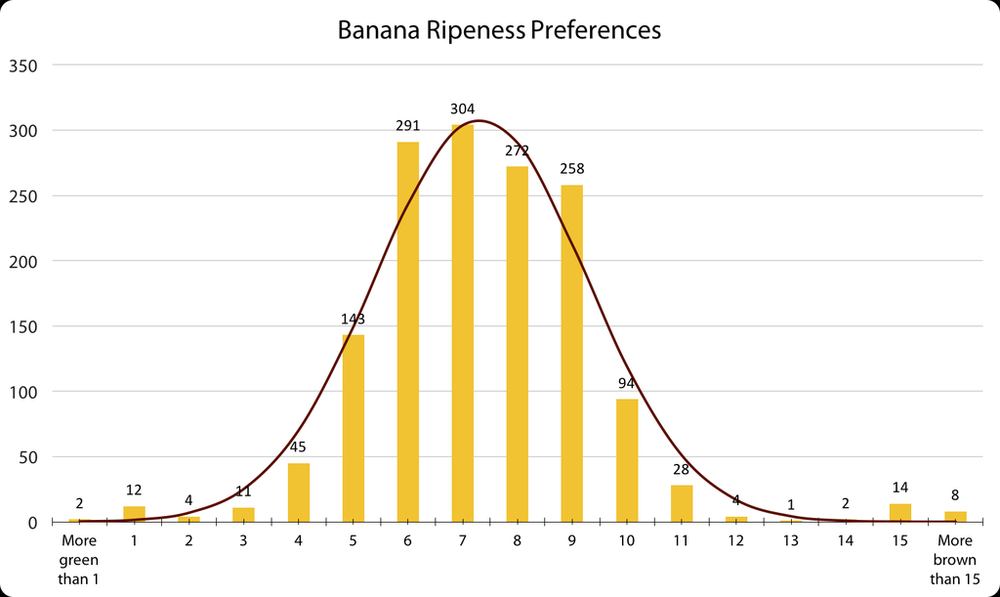
The perfect banana ripeness
https://logsandreflections.wordpress.com/2017/10/02/the-time-mtbos-went-bananas/
Notes:
Canadian teacher Ilona Vashchyshyn tweeted 2017
What’s the perfect banana ripeness? (For eating, NOT for making banana bread.)” The options were “More green than 1,” “1,” “2,” “3,” … and so on until “15,” and “More brown than 15.”
What would you expect the results to look like?
Why might there be an increase at 1 and 15??
More importantly: What might you do with this in your classroom?
The mean ripeness preference in this sample is 7.34 and the standard deviation is 1.96. This means that about 74.8% (mean +/- 1 standard deviation) of people prefer bananas that are between 6 and 9 on the ripeness scale, and about 95.8% (mean +/- 2 standard deviations) prefer bananas between 4 and 11 on the ripeness scale.
ask students to design and carry out a survey where they think they might get a similar distribution. For example, Nat suggested that a similar distribution might be observed for milk & coffee preferences, with extreme left being black – no milk – and extreme right being milk – no coffee – (although I think this might be skewed towards the left if polling adults, and right if polling teenagers).
Connect to the topic of probability by asking students to make estimates for various samples. For example, in a sample of 500 people, how many would you expect to have a banana number of 5? 10?
Have students refine the experiment to consider the effect of different factors on banana ripeness preference, such as age.

Slide 5
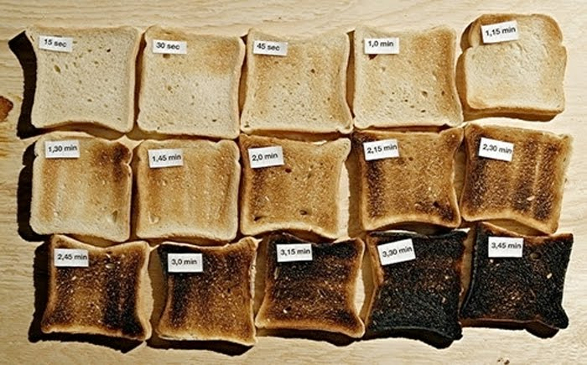
Further examples…toasting bread
http://benjaminslure.blogspot.com/2011/02/gradient.html
Notes:
Here’s another example…

Slide 6
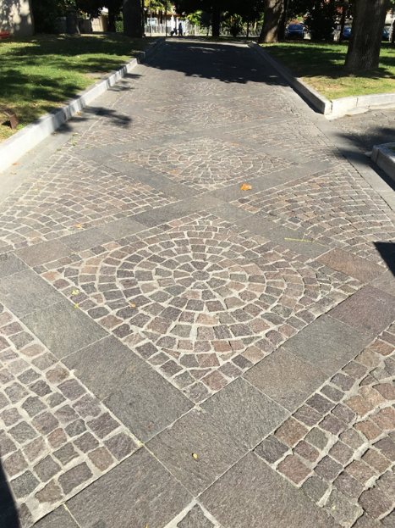
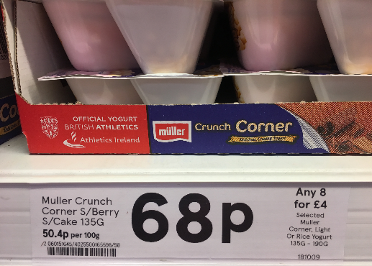
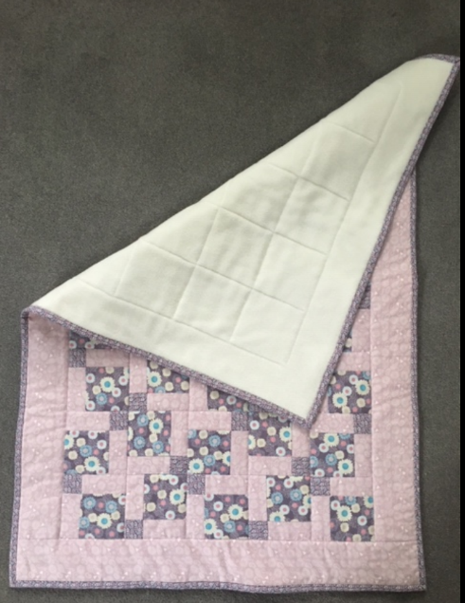
Developing problem solving/posing ideas

Slide 7
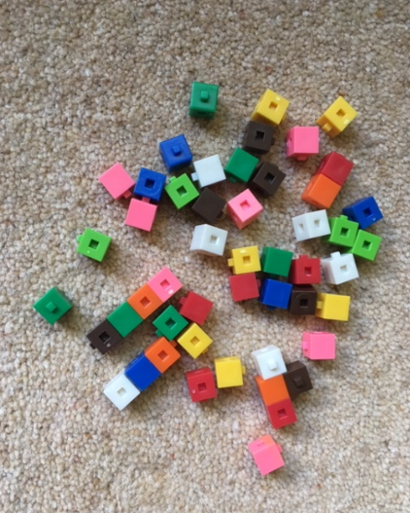
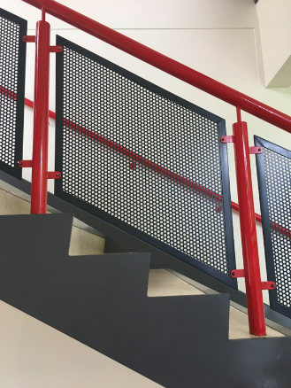
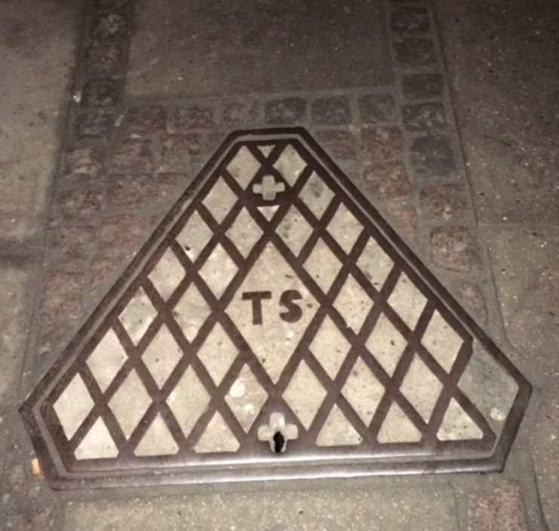
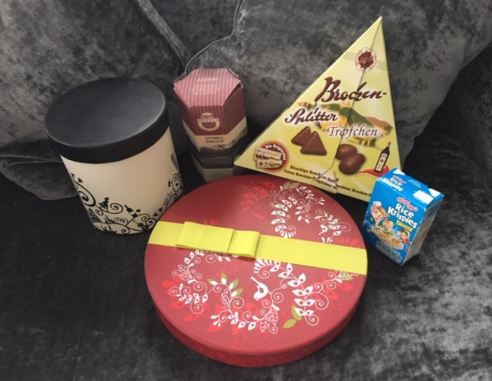
Developing problem solving/posing ideas

Slide 8
Group task
In groups of three/four:
Pose an original mathematics problem
Solve the problem if possible
Interpret any findings in the context of the original problem
Can the original problem be extended / reformulated?
Short 5-10 minutes presentation of the problem to wider group.

Slide 9
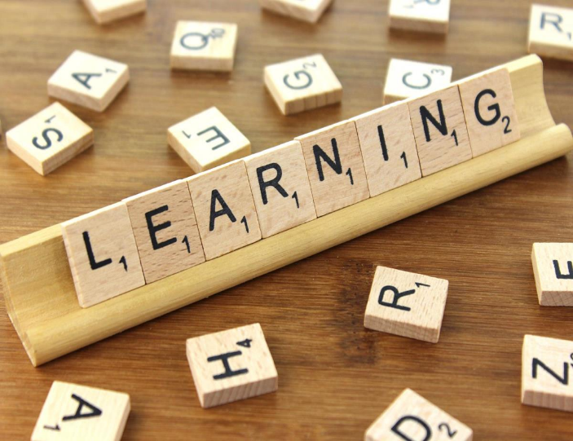
Reflecting on practice…
When regularly exposed to problems that require different strategies, students learn different ways to solve problems. As a result, students become more efficient in selecting appropriate ways to solve problems. Star and Rittle-Johnson (2008)
As students reflect on their problem-solving processes, they develop their mathematical reasoning and their ability to apply this reasoning to new situations.
Kramarski and Mevarech (2003); Siegler (2003)

