Slide 1
Using technology to present a problem solving activity
Session 2

Slide 2
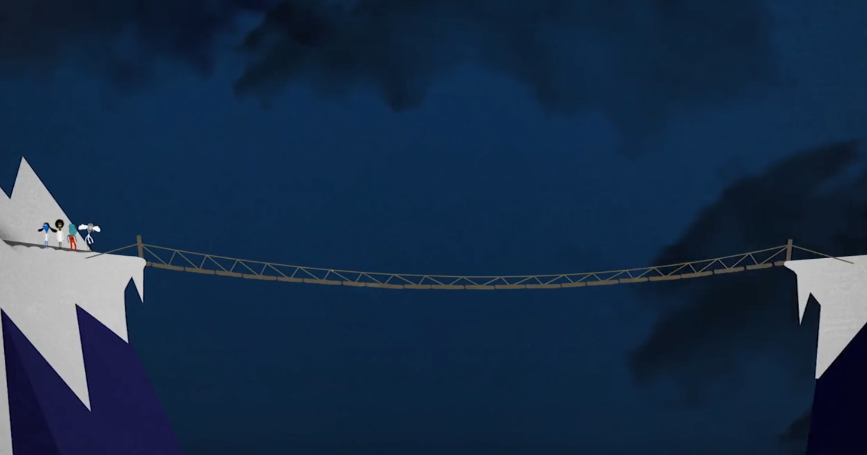
Can you solve the bridge riddle?
https://www.youtube.com/watch?v=XoXJ4elP7hk&feature=youtu.be
Notes:
Warm up
Solution on video
https://www.youtube.com/watch?v=XoXJ4elP7hk&feature=youtu.be

Slide 3
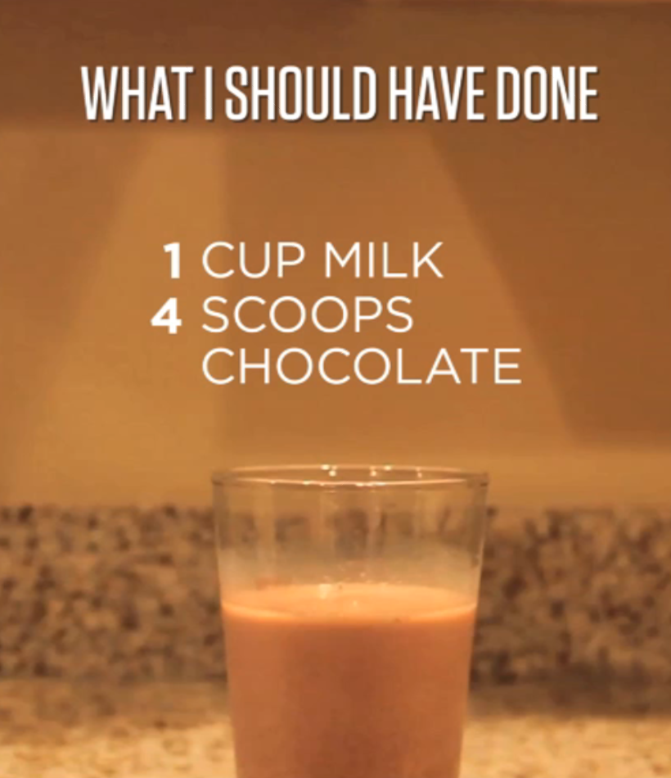
Act1-Nana’s Chocolate Milk
https://vimeo.com/37527166
Notes:
How can I fix this? How can I make it the right mix of chocolate and milk?
How many different solutions can you find?
The glass won't hold two cups of liquid. How does that affect your solution?
Would this be appropriate to use with your students?
What are the benefits of using something like this?

Slide 4
We don’t have enough milk…
The glass won’t hold that amount of milk
Add another 3 scoops of chocolate powder and 1 more cup of milk
Tell her to drink it strong!
Add ¼ cup of milk

Slide 5
To collaborate or not…
Solve the following brainteaser, without discussing it.
In a mathematics test, no two pupils scored the same.
Brian scored less than 4 and Julie scored more than 6, but did not get full marks.
Simon’s score was the sum of Brian’s and David’s.
Rachel scored three times as many as Brian.
Brian, Julie and Rachel all scored even numbers, while Simon’s and David’s scores were both odd.
David’s score was half of Rachel’s.
What did each pupil score out of 10?
Brian, David, Simon, Rachel, Julie
Brian
2
David
3
Simon
5
Rachel
6
Julie
8

Slide 6
To collaborate or not…
Collaborative learning is most effective when there are:
Group goals
Individual accountability Slavin 1995
Collaborative learning had a positive impact on problem-solving.
Zhining Qin, David Johnson, and Roger Johnson (1995).

Slide 7
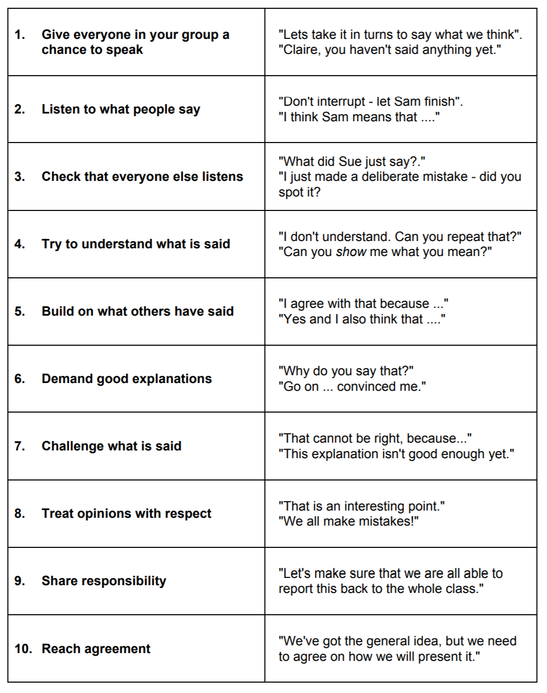
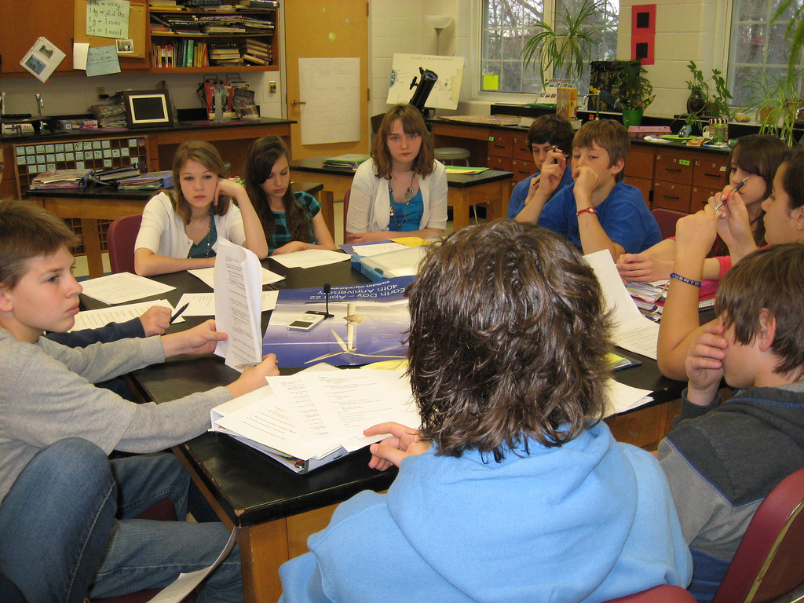
Ten ground rules for student to student discussion

Slide 8
Conversations that promote learning
Five principles of helpful classroom conversations:
Collective: teachers and students address learning tasks together, as a group or as a class, rather than in isolation
Reciprocal: teachers and students listen to each other, share ideas and consider alternative viewpoints
Cumulative: teachers and students build on their own and each others' ideas and chain them into coherent lines of thinking and enquiry
Supportive: students articulate their ideas freely, without fear of embarrassment over 'wrong' answers and they help each other to reach common understandings
Purposeful: teachers plan and facilitate dialogic teaching with particular educational goals in view Robin Alexander 2006

Slide 9
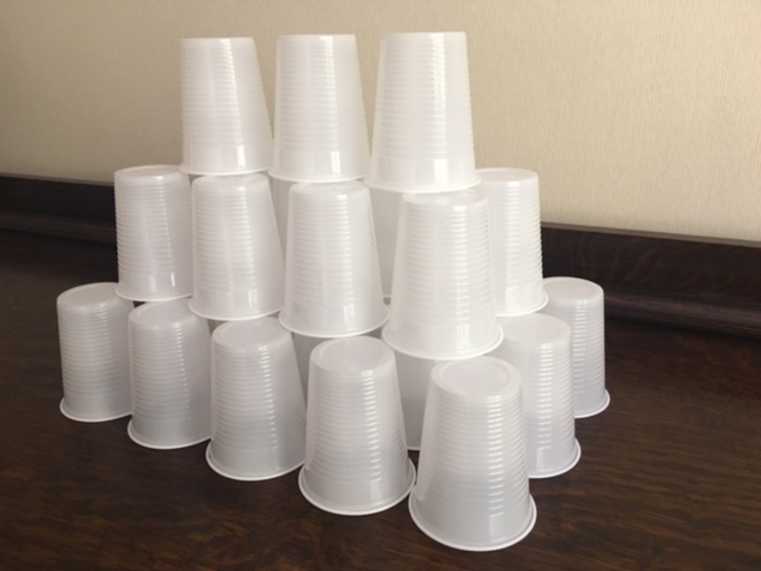
Building towers
Tracey is building towers of plastic cups.
How many cups has she used to build
this tower? How did you find out?
If Tracey wants to build a tower twice
the height, how many cups will she need?
If Tracey has 250 cups how tall can she make the tower?
Explore how Tracey could build a higher tower with 250 cups.
Notes:
26
1x3=3
2x4=8
3x5=15
2. 133
4x6=24
5x7=35
6x8=48
3. 7 layers tall takes 196 cups. To build another layer would take 276 cups. Tracey only has 250 cups so 8 layers is not possible.

Slide 10
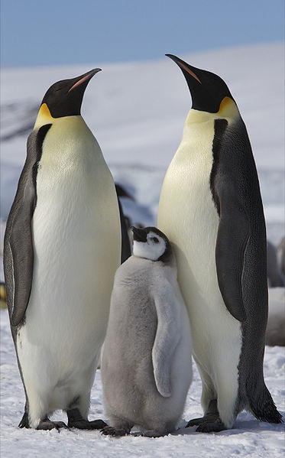
Why do penguins huddle?
Watch the video: https://www.youtube.com/watch?v=OL7O5O7U4Gs
Emperor penguins huddle together to escape wind and conserve warmth.
Why is this effective?

Slide 11
Why do Emperor penguins - continued
Use an approximation for height and body diameter (100cm x 50cm)
Start by constructing models
Use appropriate mathematical methods and present your findings
< 5 cm >
< 5 cm >
< 10 cm >
Notes:
Consider all the different types of maths we have used in this activity

Slide 12
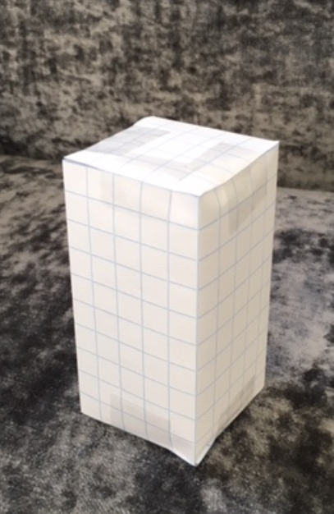
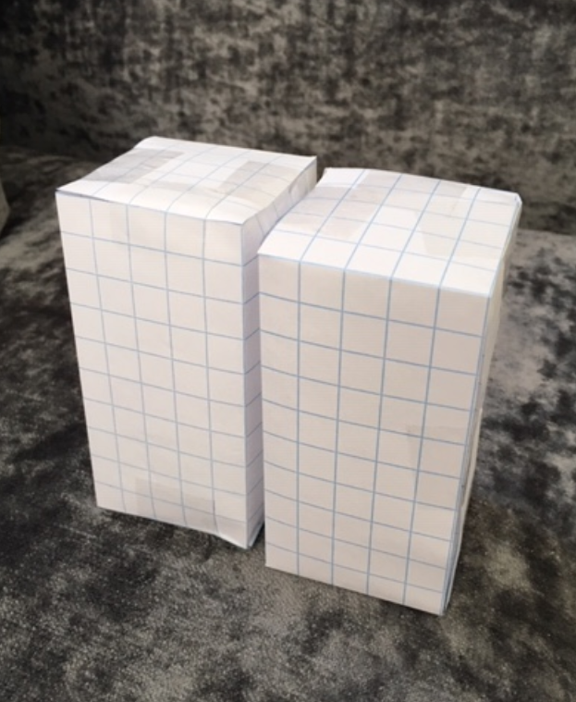
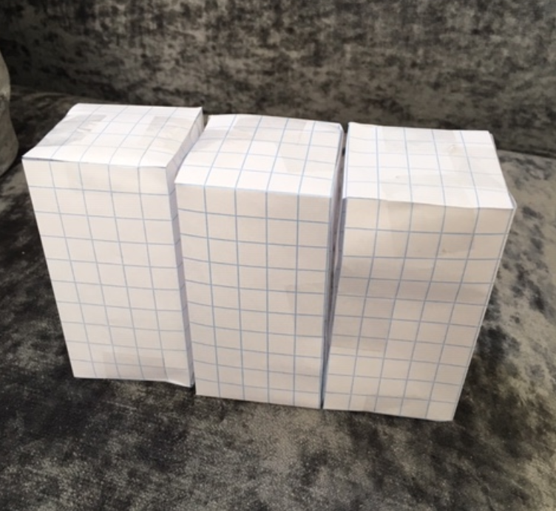
Penguins arranged in a line
1 penguin - 4 rectangular faces exposed
2 penguins - 3 rectangular faces exposed
1 penguin 2 rectangular faces exposed
2 penguins - 3 rectangular faces exposed
Notes:
Students often start by exploring by arranging the ‘penguins’ in one line
Encourage lots of discussion and demonstration
Students should consider how they would record their findings -

Slide 13
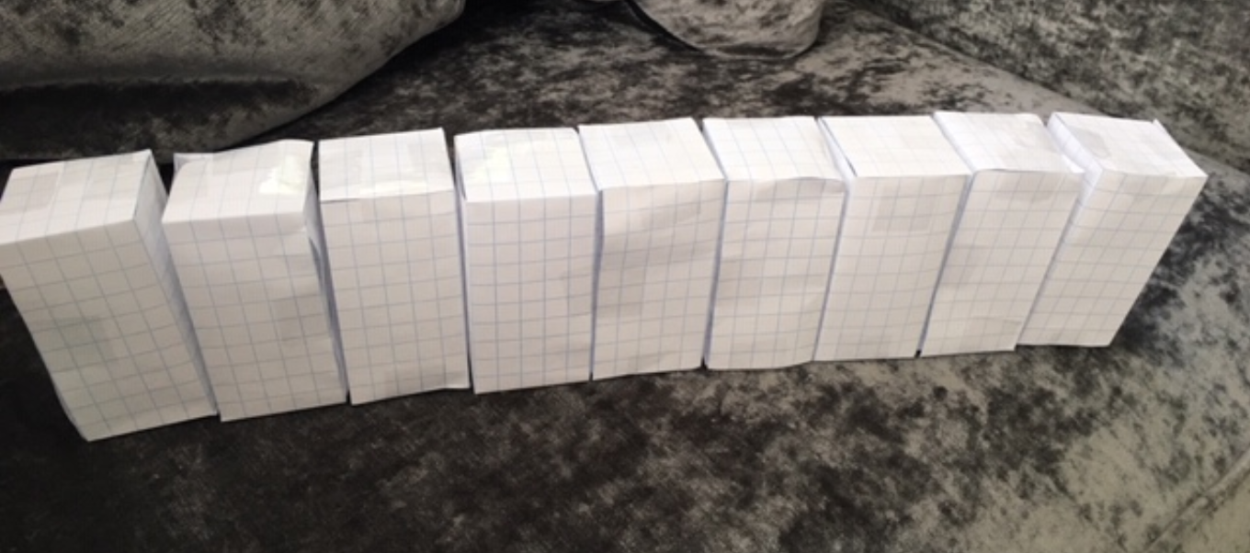
A line of penguins!
Notes:
What do you notice about the number of rectangular faces exposed to the cold?
What would happen if…
One more penguin joined the line?
Two more penguins joined the line?

Slide 14
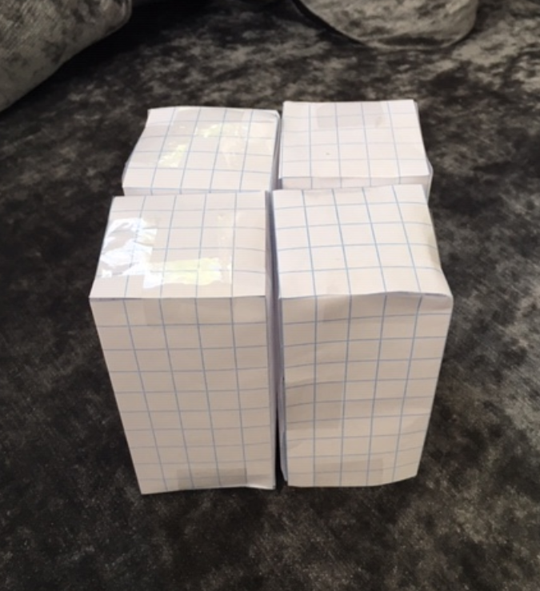
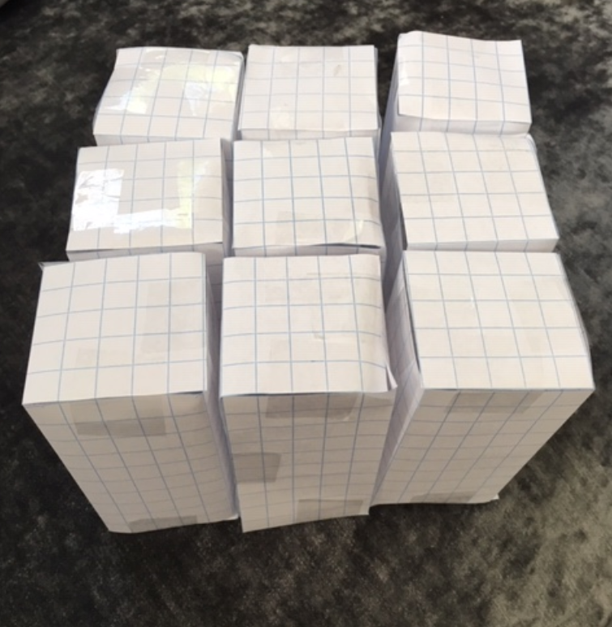
Other arrangements of penguins!
Notes:
Explore patterns of penguins
Consider how best to record and present your findings

Slide 15
Implications for the classroom
The clever crow video
https://www.youtube.com/watch?v=EZSk7oCNaHg
Watch the video and consider what characteristics / types of behaviour we want to help our students develop?
Notes:
It is a short video so you may want to watch it twice – the solution happens quite quickly!

Slide 16
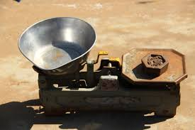
Old fashioned weighing scales
Craig is helping his mother in the farm shop to weigh potatoes. He is using scales similar to the picture below.
Craig has lost some of the weights. He can only find 3 weights.
Craig says this is not a problem. He can still weigh any whole number of kilograms between 1kg and 13kg.
What weights does he have?
How can he weigh 1kg to 13kg?

Slide 17
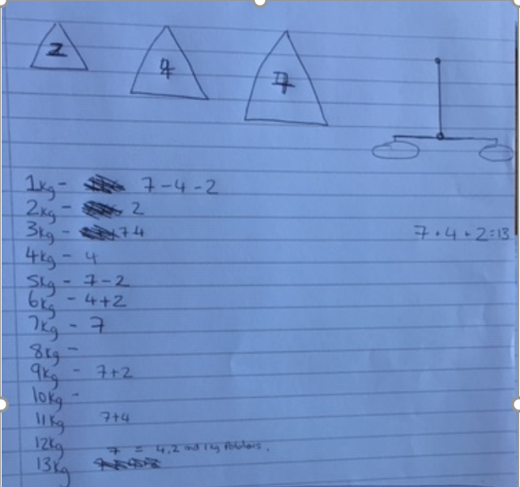
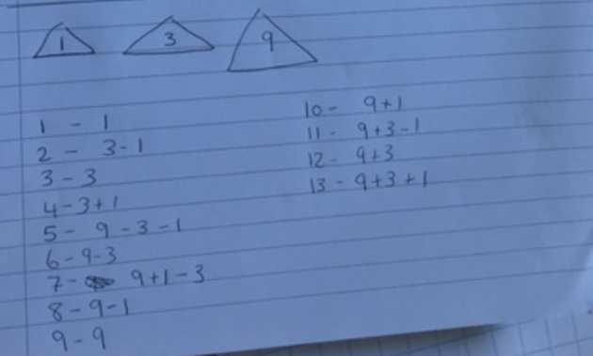
Student work – sample 1
Notes:
This student started by weighing potatoes and put them into 1kg bags. In this way he has all weights up to 13kg. How would you respond to this suggestion? – see drawing of scales on right hand side of first page.
What good things can you see in this sample?

Slide 18
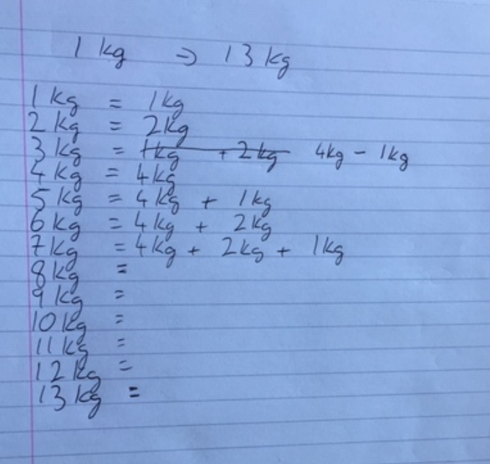
Student work – sample 2
Notes:
What thinking can you see in this example?
How would you encourage persistence?

Slide 19
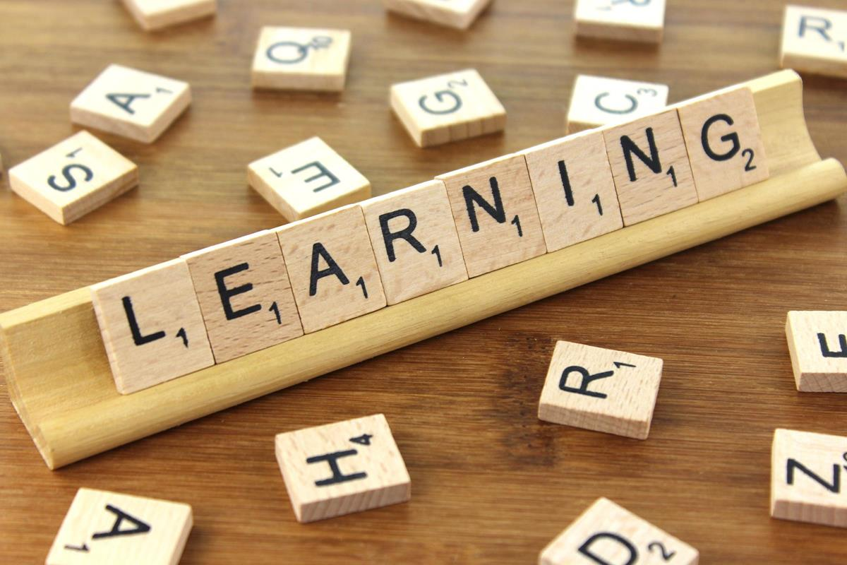
Reflecting on practice…
Students learn mathematics and are more effective at solving problems when they monitor their thinking and reflect on the problem solving process as they solve problems.
Hohn and Frey (2002); Jitendra et al.(2009); Jitendra et al. (2010)
Generating multiple strategies in peer tutoring dyads appears to be more beneficial to students than having them generate multiple strategies individually.
Ginsburg-Block and Fantuzzo (1998)

