Slide 1
Using technology to present a problem solving activity Session 1

Slide 2
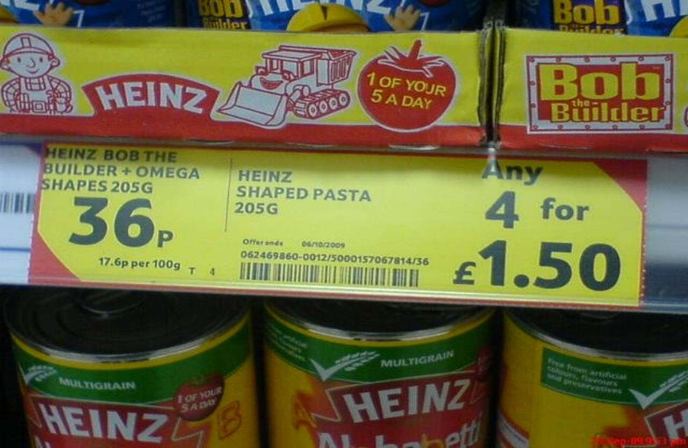
Notes:
How much we would save by purchasing 4 tins of pasta?
5 mins – think, pair, share – then try to find different solutions to the problem…

Slide 8
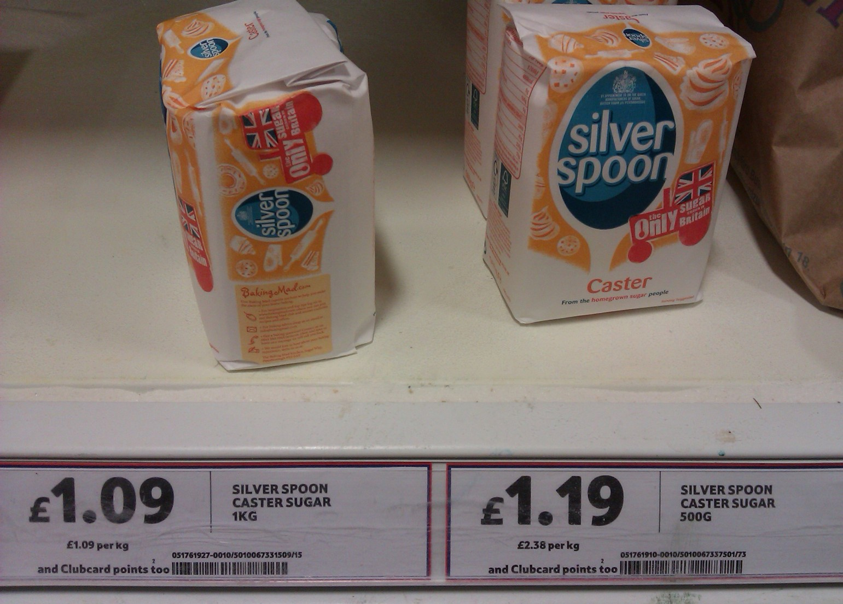
Notes:
Photographs can bring real life scenarios into the classroom to demonstrate a relevance to maths
Can you spot any issues?
More expensive to purchase the smaller amount of sugar!

Slide 9
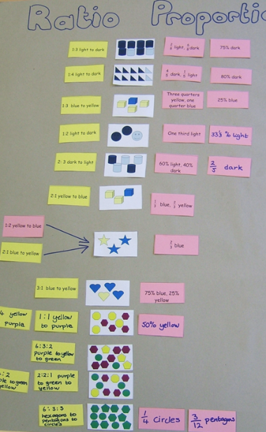
Other tools -sharing learning…
Notes:
Using technology to share work and have students explain what they have done with Bob the builder

Slide 10
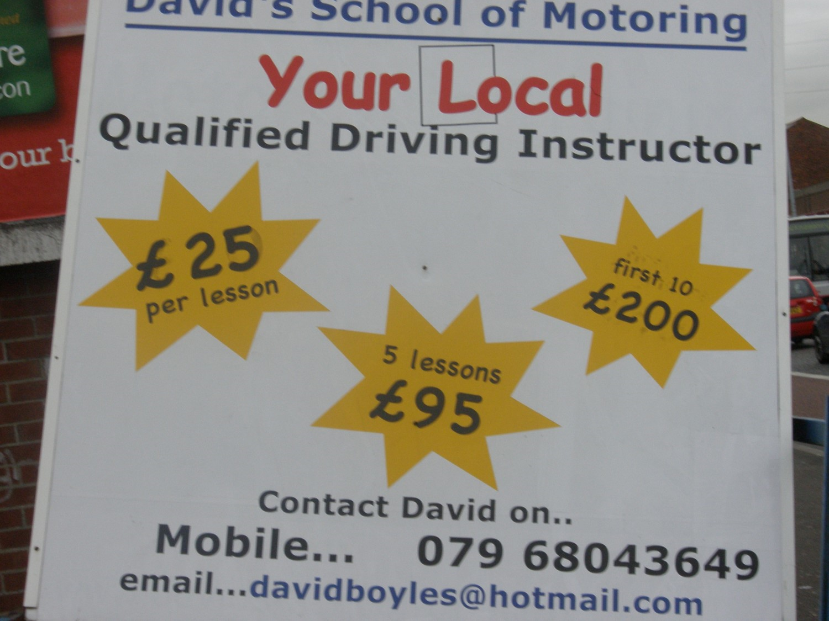

Slide 11
Using technology to construct a spreadsheet…
single lesson cost (£) | 5 lesson cost (£) | 10 lesson cost (£) | lowest possible | purchase required
25 | 95 | 200 | 25 | add single
50 | 95 | 200 | 50 | add single
75 | 95 | 200 | 75 | add single
100 | 95 | 200 | 95 | add 5
125 | 95 | 200 | 95
150 | 190 | 200 | 120 | add single
175 | 190 | 200 | 145 | add single
200 | 190 | 200 | 170 | add single
225 | 190 | 200 | 190 | add 5
250 | 190 | 200 | 190
275 | 285 | 400 | 215 | add single
300 | 285 | 400 | 240 | add single
325 | 285 | 400 | 265 | add single
350 | 285 | 400 | 285 | add 5
375 | 285 | 400 | 285
400 | 380 | 400 | 310 | add single
425 | 380 | 400 | 335 | add single
450 | 380 | 400 | 360 | add single
475 | 380 | 400 | 380 | add 5
500 | 380 | 400 | 380

Slide 12
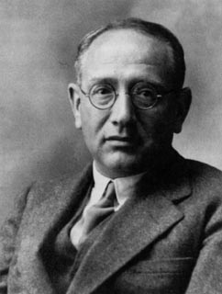
Mathematical Ways of Working
Understand the problem
Devise a plan
Carry out the plan
Look back Review
George Pólya (1887 – 1985)
Notes:
Pólya’s 4 stages to problem solving – Don’t rush into the problem!!
1. Understand the problem – What is involved in this problem? What is the question to be answered? What information do I have? What do I need to find out?
2. Make a plan – at this stage mathematicians engage in some very important activities often missed by low achieving learners such as: draw a picture; making a chart with the numbers; trying a smaller/simpler case
3. Carry out the plan, checking each step.
4. Look back over work – is the answer reasonable?
Some of these strategies seem obvious to teachers but they are often missing from the work of low achievers
Emphasise this process but also flexibility

Slide 13
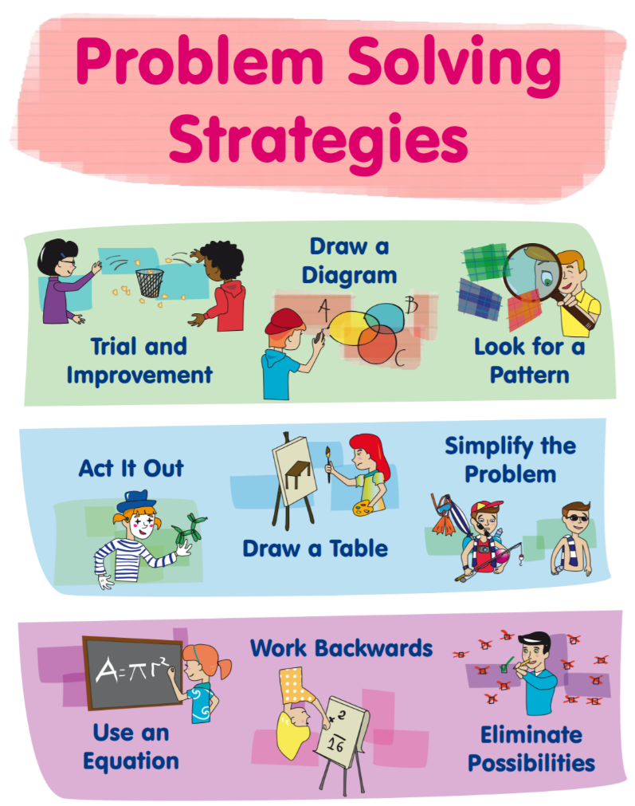
https://www.projectmaths.ie/workshops/workshop3/ProblemSolvingPosters.pdf
Notes:
How do we teach students to be confident using different strategies?

Slide 14
Exploring problems – some questions to reflect on…
How might we present the problem to engage students?
What technology is appropriate for the teacher/practitioner to use?
What technology is appropriate for the student to use?
Will the technology enhance the learning?
Notes:
As we explore the following problems –
Reflect on how we might present the problem to engage students?
What technology is appropriate for the teacher/practitioner to use?
What technology is appropriate for the student to use?
When will the technology enhance the learning? – don’t be afraid to use technology and manipulatives…
Always keep in mind – will the technology enhance the learning?

Slide 15
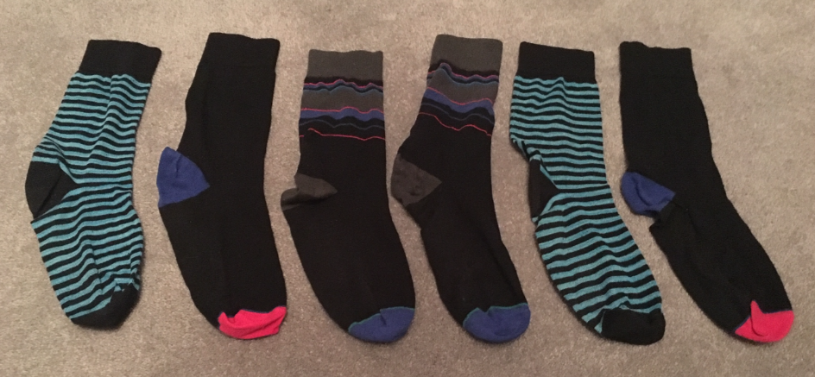
Socks and matching pairs
Emily’s dad is in a rush to get dressed. Without looking, he grabs 2 socks from the drawer.
What is the chance that he grabs a matching pair?

Slide 16
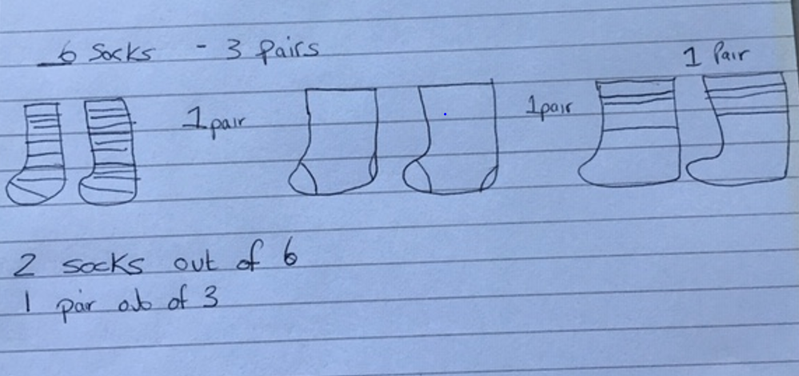
Students’ work sample 1… Consider how you would promote learning?

Slide 17
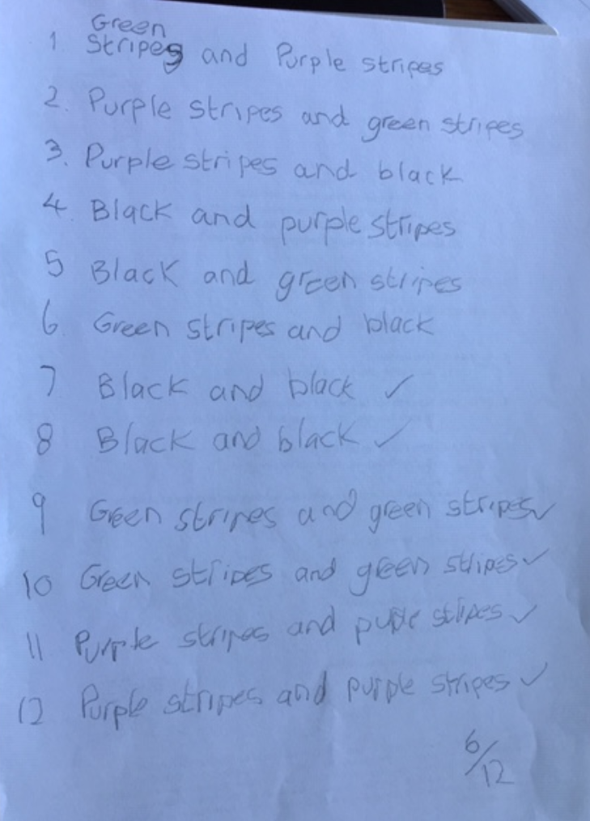
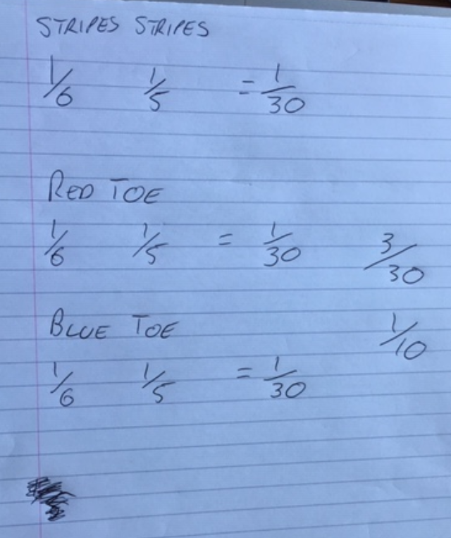
Student work samples 2 & 3 Consider how you would address these?

Slide 18
Matching socks
 | Stripe | Pink toe | Blue toe | Blue toe | Stripe | Pink toe
Stripe | SS | SP | SB | SB | SS | SP
Pink toe | PS | PP | PB | PB | PS | PP
Blue toe | BS | BP | BB | BB | BS | BP
Blue toe | BS | BP | BB | BB | BS | BP
Stripe | SS | SP | SB | SB | SS | SP
Pink toe | PS | PP | PB | PB | PS | PP
Notes:
How will the students identify the socks? Do we tell them or require them to initiate it themselves?
Do we give them a table or do we let them explore and try to find a systematic way of finding all possibilities?

Slide 19
Matching socks
Anna comments, “There are 6 ways of getting a matching pair of socks”.
 | Stripe | Pink toe | Blue toe | Blue toe | Stripe | Pink toe
Stripe | SS | SP | SB | SB | SS | SP
Pink toe | PS | PP | PB | PB | PS | PP
Blue toe | BS | BP | BB | BB | BS | BP
Blue toe | BS | BP | BB | BB | BS | BP
Stripe | SS | SP | SB | SB | SS | SP
Pink toe | PS | PP | PB | PB | PS | PP
Notes:
One student suggests there are 6 ways of getting a matching pair of socks

Slide 20
Matching socks
Ben suggests,
“There are 12 ways of getting a pair of socks so $\frac{1}{3}$ chance of picking a matching pair”.
 | Stripe | Pink toe | Blue toe | Blue toe | Stripe | Pink toe
Stripe | SS | SP | SB | SB | SS | SP
Pink toe | PS | PP | PB | PB | PS | PP
Blue toe | BS | BP | BB | BB | BS | BP
Blue toe | BS | BP | BB | BB | BS | BP
Stripe | SS | SP | SB | SB | SS | SP
Pink toe | PS | PP | PB | PB | PS | PP
Notes:
Another student suggests there are 12 ways…why can this not happen?

Slide 21
In patchwork terminology this quilt is made up of half square triangles. How many squares can you see? Explore the relationship between squares and triangles. Plan how you will approach this problem.
Triangles and squares

Slide 22
One way to consider the problem

Slide 23
An alternate way to explore the pattern…

Slide 24
Another pattern to explore…

Slide 25
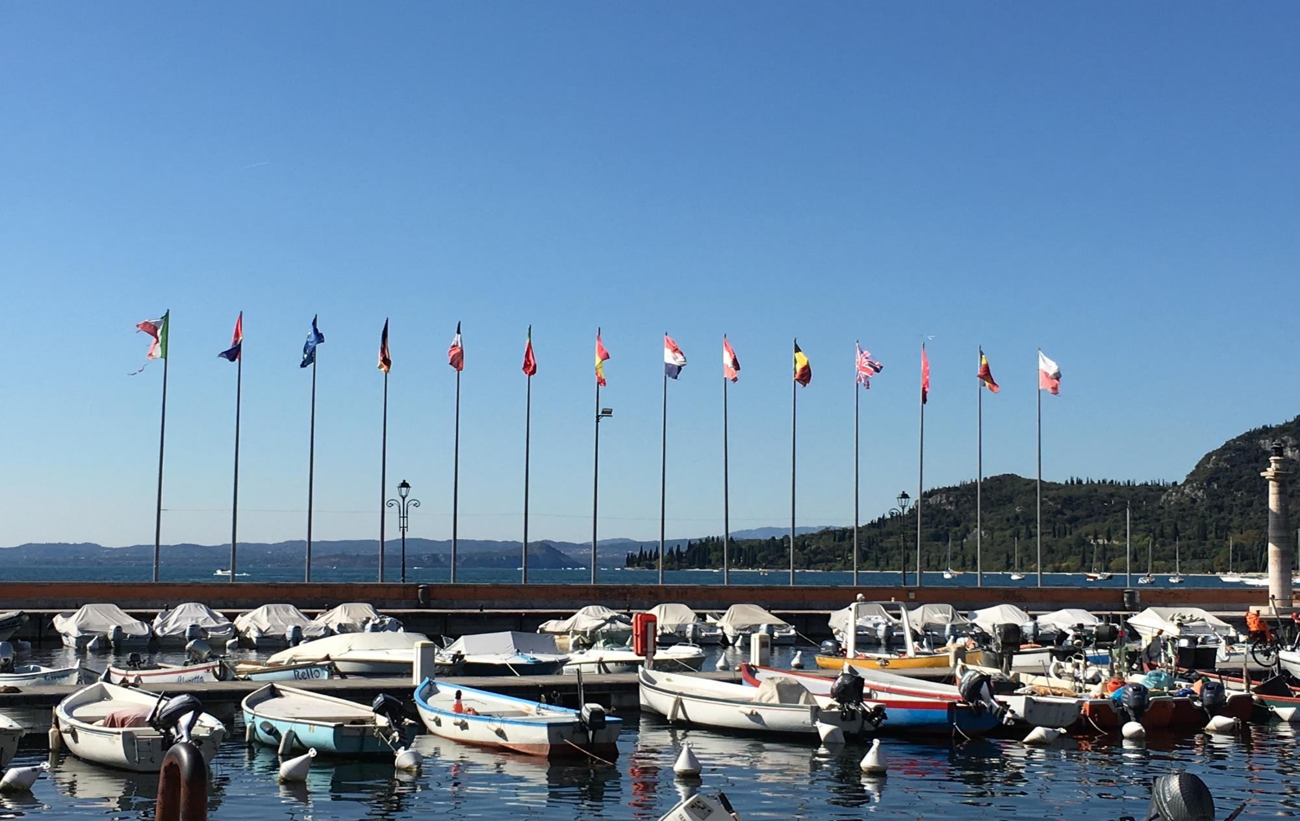
Notes:
How many different ways could we fly the flags above?
Would it be easier to start with an easier example?

Slide 26
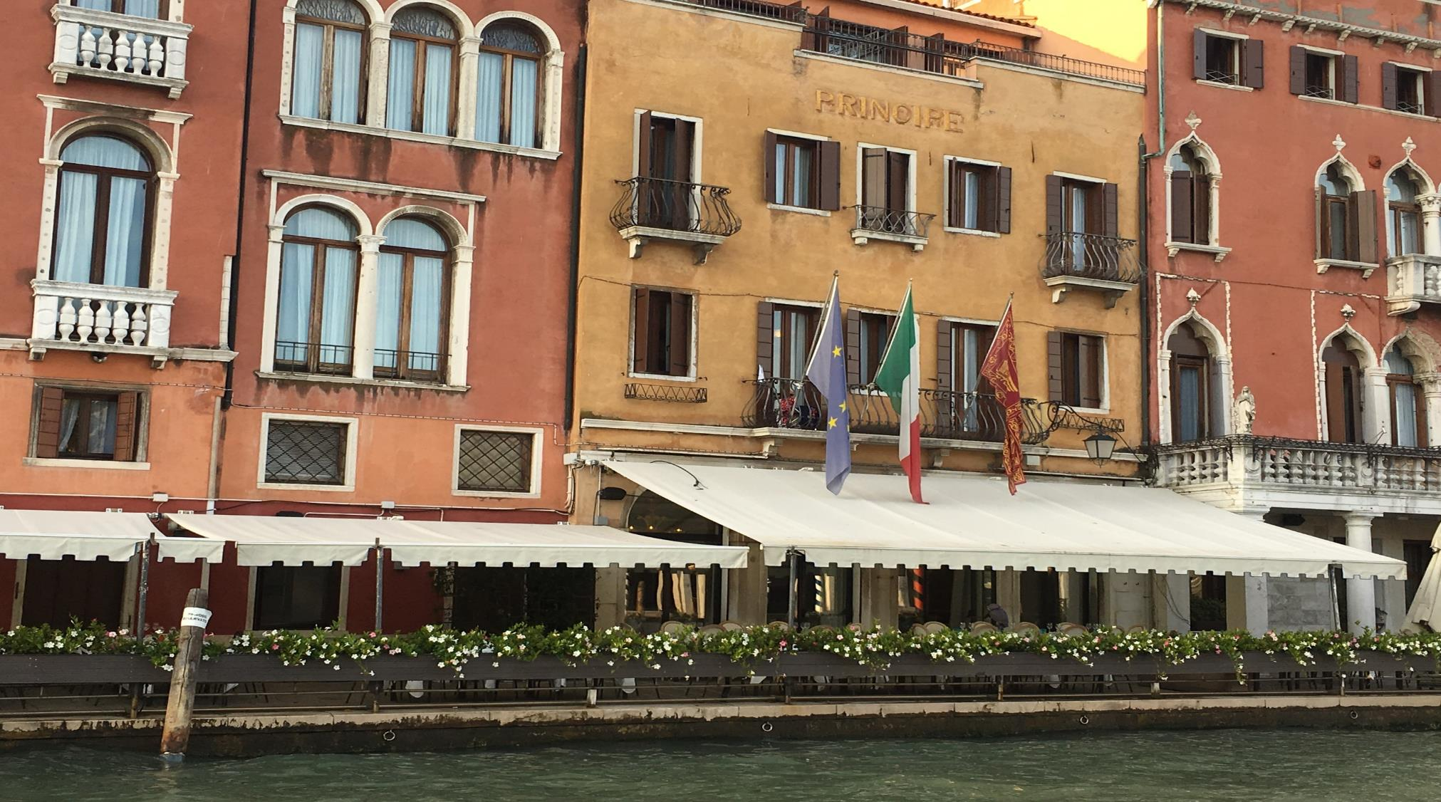
Notes:
How many different ways could the flags be flown?
Can you spot a pattern? How would we do this?
1 flag = 1 way
2 flags = 2 ways = 2x1 (note case of 1 and 2 don’t always add to the understanding)
3 flags = 6 ways = 3x2x1
What about 4 flags? Add one into table of 3 so each 4 x 6 = 24 ways… starting to get an idea of factorial numbers…put one flag in position 1 then the remaining flags can go into 6 combinations, then put 2nd flag into position 1 and the remaining 3 flags can be rearranged 6 times and so on…

Slide 27
14!
= 87 178 291 200
Notes:
Although this appears an easy challenge, we must prepare for our students and make the challenge appropriate!
Value of 14! i.e., Factorial of 14 = 87,178,291,200. In general, the factorial of a number N = N*(N-1)*(N-2)....1.

Slide 28
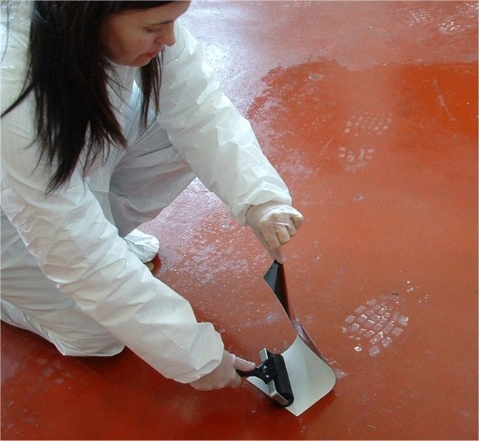
Crime Scene Investigation
Notes:
Structured and unstructured problems – when to use?
Envelopes with the instructions – different for structured and unstructured

Slide 29
D.B. Russell Crime Scene Investigators
Footprint = 15%
100% = ?
Measure feet
inches / cm
shoe size?
“the length of a footprint is 15% of a person’s height”
Collect data from your group and use this to support or refute this claim
Present your findings in an appropriate way
How many learners will be in your sample?
Notes:
29

Slide 30
Reflecting on practice
A sustained focus on problem solving is often missing in the mathematics classroom.
Stodolsky (1988)
Daily maths lessons are often limited to learning and practising new skills, leaving little time for problem solving.
Porter (1989); Weiss et al. (2003)

