Slide 1
Problem solving approaches Session 3 – problem posing

Slide 2
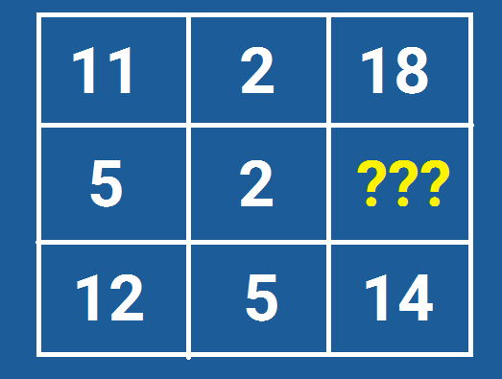
Warm up problem!

Slide 3
What is problem posing?
“It is a cognitive activity which encompasses both the generation of new problems and the reformulation of given problems.”
(English, 2004; Whitin, 2006).
“The ability to formulate mathematical problems, represent them and solve them.”
(Kilpatrick, Swafford & Findell, 2001, p.124).
“The process by which, on the basis of mathematical experience, students construct personal interpretations of concrete situations and formulate them as meaningful mathematical problems.”
(Stoyanova & Ellerton, 1996, p.518).

Slide 4
Problem posing
“The formulation of a problem is often more essential than its solution.”
(Einstein & Infeld, 1938)
“The mathematical experience of the student is incomplete if they never had an opportunity to solve a problem invented by themselves.”
(Polya, 1957, p.68)
“The experience of discovering and creating one’s own mathematics problems ought to be part of every student’s education.”
(Kilpatrick, 1987, p.123)

Slide 5
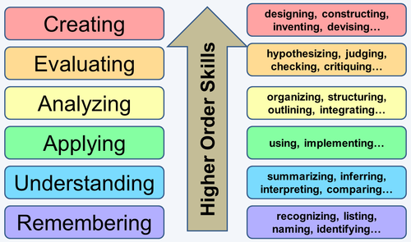
Bloom’s taxonomy

Slide 6
Problem posing
“The formulation of a problem is often more essential than its solution, which may be merely a matter of mathematical or experimental skill. To raise new questions, a new possibility, to regard old problems from a new angle, requires creative imagination and marks real advances in sciences.”
(Einstein & Infeld, 1938).

Slide 7
Problem posing: contexts for 3 – 1 = 2
(1) I was given three apples, and then ate one of them. How many were left?
(2) A barge-pole three metres long stands upright on the bottom of the canal, with one metre protruding above the surface. How deep is the water in the canal?
(3) A train was due to arrive one hour ago. We are told that it is three hours late. In how many hours can we expect it to arrive?
(4) How many cuts do you have to make to saw a log into three pieces?
(Mason, 2016).

Slide 8
Categories of problem posing
Free – students design problems from a real life context without restrictions.
Christian Eriksen has made 75 appearances for Denmark and has scored 21 goals. He has made 160 appearances for his club Tottenham hotspur and has scored 38 goals. Write and solve as many problems as you can using this information.

Slide 9
Categories of problem posing
Semi-structured – students are given an open situation and invited to explore the structure using previous maths knowledge.
In the diagram, there is a cube. Make up as many problems as you can that are in some way related to this diagram.

Slide 10
Categories of problem posing
3. Structured – the activity is centred on a specific problem that requires completion or reformulation.
11% of a number is 77. Write and solve as many problems as you can using this information.

Slide 11
Issues with problem posing
“While problem posing is recognised as fundamental to the teaching and learning of mathematics, it remains on the periphery of school curricula.” (Ellerton, Singer, & Cai, 2015).
“It has been marginalised by the mathematics education community.” (Crespo, 2003).
“There are a lack of opportunities provided to students to generate and reformulate their own problems.” (Leung, 2013).

Slide 12
Problem posing
It is also important that practitioners are able to create interesting problems for their students.
(Olson & Knott, 2013)

Slide 13
The emergence of problem posing
Maths Eyes Competition in Ireland
http://www.haveyougotmathseyes.com/
Students develop maths problems from the world around them…(free problem posing)!

Slide 14
Problem posing using ‘Maths Eyes’

Slide 15
Problem posing using ‘Maths Eyes’

Slide 16
Problem posing using ‘Maths Eyes’

Slide 17
Problem posing using ‘Maths Eyes’

Slide 18
Problem posing using ‘Maths Eyes’

Slide 19
Problem posing using ‘Maths Eyes’

Slide 20
Problem posing using ‘Maths Eyes’

Slide 21
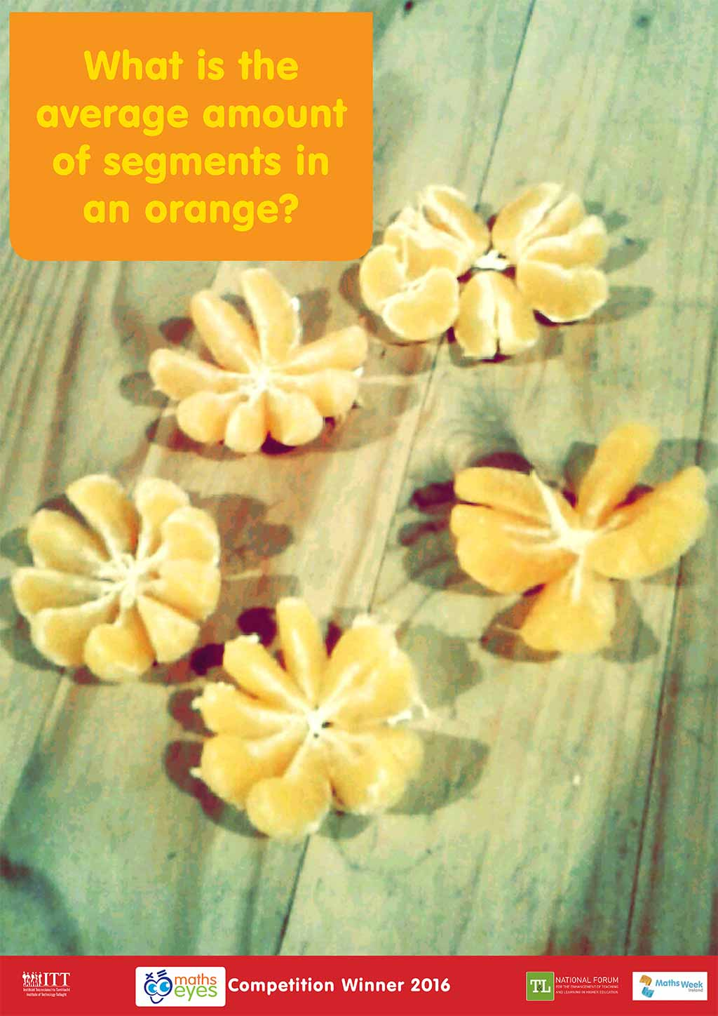
Problem posing using ‘Maths Eyes’

Slide 22
Problem posing using ‘Maths Eyes’

Slide 23
Problem posing using ‘Maths Eyes’

Slide 24
Problem posing using ‘Maths Eyes’

Slide 25
Problem posing using ‘Maths Eyes’

Slide 26
Posing posing in reformed Irish maths curriculum
At the end of second year students will, over a three week period follow the problem-solving cycle to investigate a mathematical problem.
Define a problem.
Decompose it into manageable parts.
Translate the problem to mathematics.
Engage with the problem.
Solve the problem if possible.
Interpret any findings in the context of the original problem.

Slide 27
Group task
In groups of three/four:
Pose an original mathematics problem using your ‘Maths Eyes’ (can take any form – doesn’t have to be a picture).
Solve the problem if possible.
Interpret any findings in the context of the original problem.
Can the original problem be extended / reformulated?
Short 5-10 minutes presentation of the problem to wider group.

Slide 28
Notes:
Poll Title: One thing I have learned today (Tuesday)...... https://www.polleverywhere.com/free_text_polls/HcCuyMxtngf8GZ4

