Slide 1
Problem solving approaches
Session 2 – Problem solving

Slide 2
Polya’s 4 stages of problem solving
Stage 1 Understanding the problem
Stage 3 Carry out the plan
Stage 4 Look back/review
Stage 2 Devising a plan

Slide 3
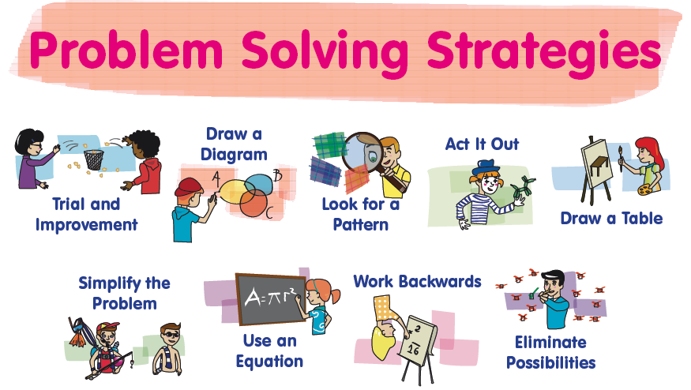

Slide 4
Teachers as problem solvers…
“It seems a little incongruous to suggest that teachers who have not experienced inquiry in their own lives will be able to create classroom settings which encourage students to question, to pose and solve problems, and to be self directed learners.”
(Beattie, 1997, p. 114).
“A teacher who is not always thinking about solving problems – ones they do not know the answer to – is psychologically simply not prepared to teach problem solving to their students.”
(Halmos, 1985, p.322).

Slide 5

Problem 1 – inquiry cubes

Slide 6
Problem 2
sum
^

Slide 7
Solution…
Not possible, why?
Even + Even = Even / Odd + Odd = Even
O + O + O + O + O + O + O + O + O + O
E + E + E + E + E
E + E + E
E + E
= E

Slide 8
Problem 3
You are a prisoner sentenced to death. Your captor offers you a chance to live by playing a simple game. He gives you 20 yellow cubes, 20 red cubes and 2 empty bowls. He then says “Divide these 40 cubes into these 2 bowls. You can divide them any way you like as long as you use all the cubes. Then I will blindfold you and mix the bowls around. You can then choose one bowl and remove one cube. If the cube is YELLOW you will live but if the cube is RED you will die.”
How do you divide the cubes up so that you have the greatest probability of choosing a YELLOW cube?

Slide 9
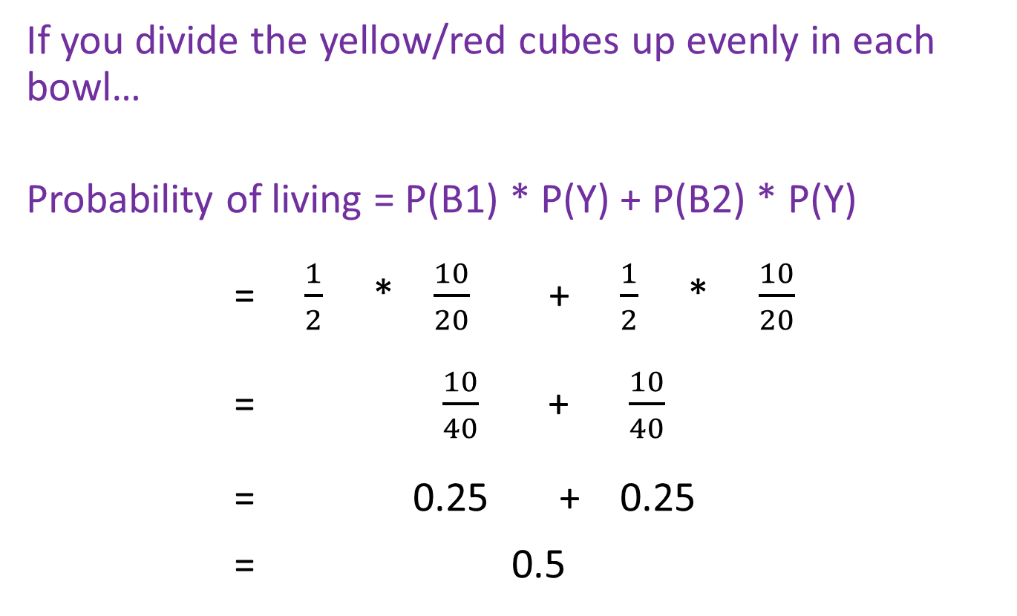
Possible solution
If you divide the yellow/red cubes up evenly in each bowl…
Probability of living = P(B1) * P(Y) + P(B2) * P(Y)
= $\frac{1}{2}$ * $\frac{10}{20}$ + $\frac{1}{2}$ * $\frac{10}{20}$
= $\frac{10}{40}$ + $\frac{10}{40}$
= 0.25 + 0.25
= 0.5

Slide 10
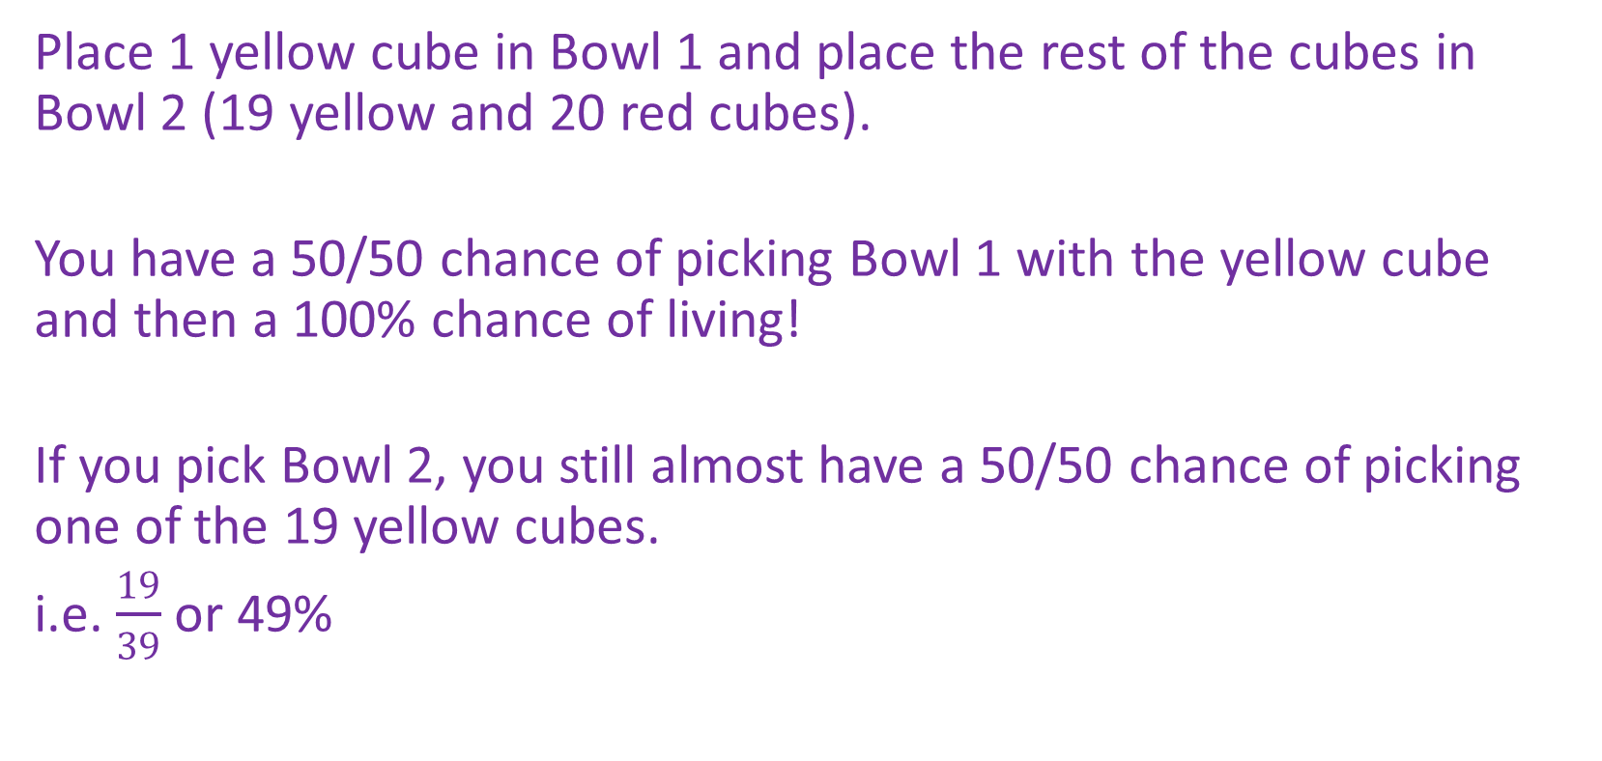
Alternative solution…
Place 1 yellow cube in Bowl 1 and place the rest of the cubes in Bowl 2 (19 yellow and 20 red cubes).
You have a 50/50 chance of picking Bowl 1 with the yellow cube and then a 100% chance of living!
If you pick Bowl 2, you still almost have a 50/50 chance of picking one of the 19 yellow cubes.
i.e. $\frac{19}{39}$ or 49%

Slide 11

Probability behind the solution
Probability of Living = P(B1) * P(Y) + P(B2) * P(Y)
= $\frac{1}{2}$ * 1 + $\frac{1}{2}$ * $\frac{19}{39}$
= $\frac{1}{2}$ + $\frac{19}{78}$
= 0.5 + 0.24
= 0.74

Slide 12
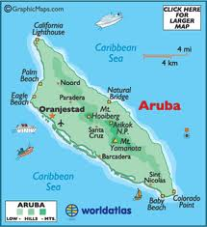
Problem 4
The island of Aruba is well known for its beaches and predictable warm, sunny weather. In fact, Aruba’s weather is so predictable that the daily newspapers don’t even bother printing a forecast. Strangely enough, however, on New Year’s Eve 2012, as the islanders were counting down the last 10 seconds of 2012, it began to rain. What is the probability, from 0 to 1, that 72 hours later the sun will be shining?

Slide 13
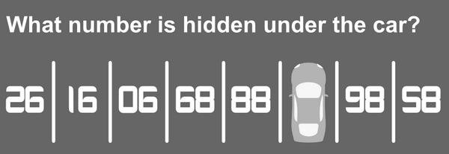
Problem 5

Slide 14
Problem 5

Slide 15
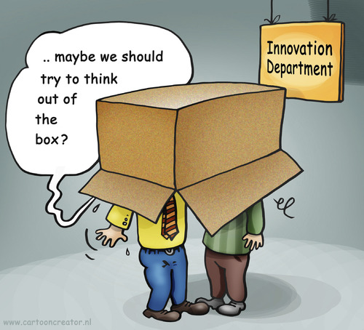
Lessons from problem 4 and 5
Don’t always look for a mathematical procedure or formula straight away.
Logic has a prominent role to play in mathematics.
Encourage students to think outside the box

Slide 16
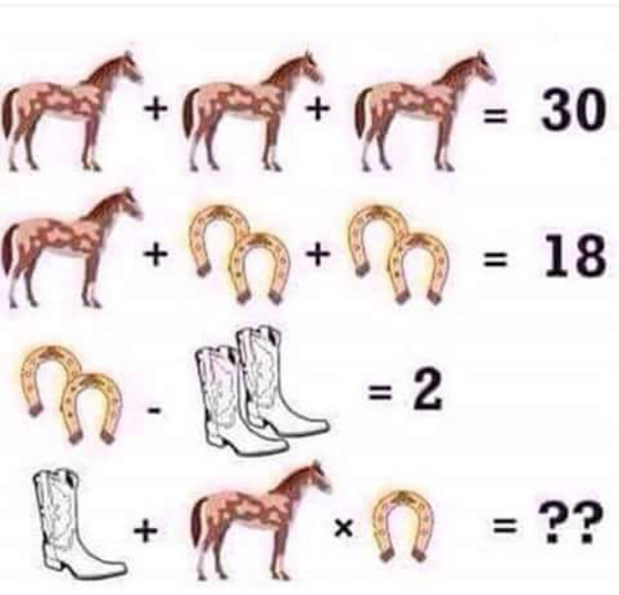
Problem 6
= 21

Slide 17
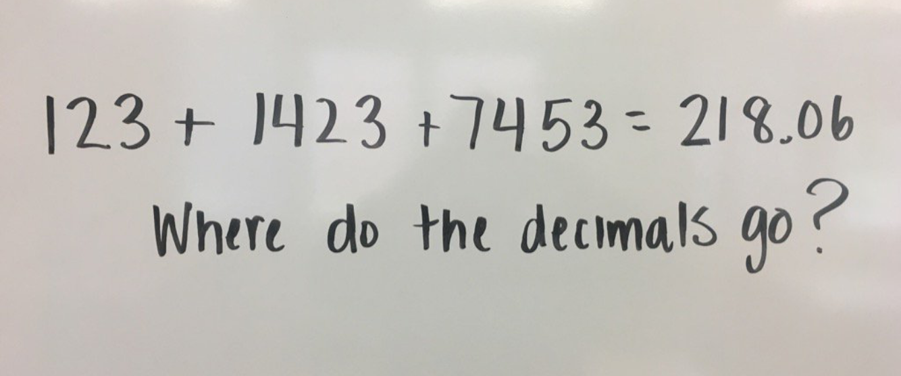
Problem 7

Slide 18
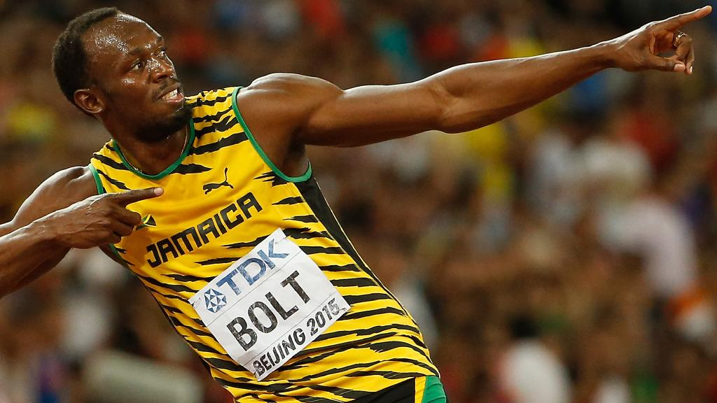
Problem 8
In the 2012 Olympics, Usain Bolt from Jamaica won the gold medal in the 100m race with a time of 9.63s. In the first ever event of the modern Olympic games in April 1896, Thomas Burke from the US won the 100m race in a time of 12s. If both athletes ran in the same 100m race repeating their respective performances, what would be the distance between the athletes at the finish line?
https://www.youtube.com/watch?v=2O7K-8G2nwU

Slide 19
Possible solution
Bolt: 100m in 9.63s
Burke: 100m in 12s
Speed = distance/time
Burke speed = 100/12 = 8.33m/s
In 9.63s Burke would have ran (8.33 x 9.63) 80.25m
In 9.63s Bolt runs 100m
Therefore the distance between Bolt and Burke at the finish line would be 19.75m.

Slide 20
Problem 9
The volume of a shape is 216, what can it be?
(Adapted from Boaler, 1998).

Slide 21
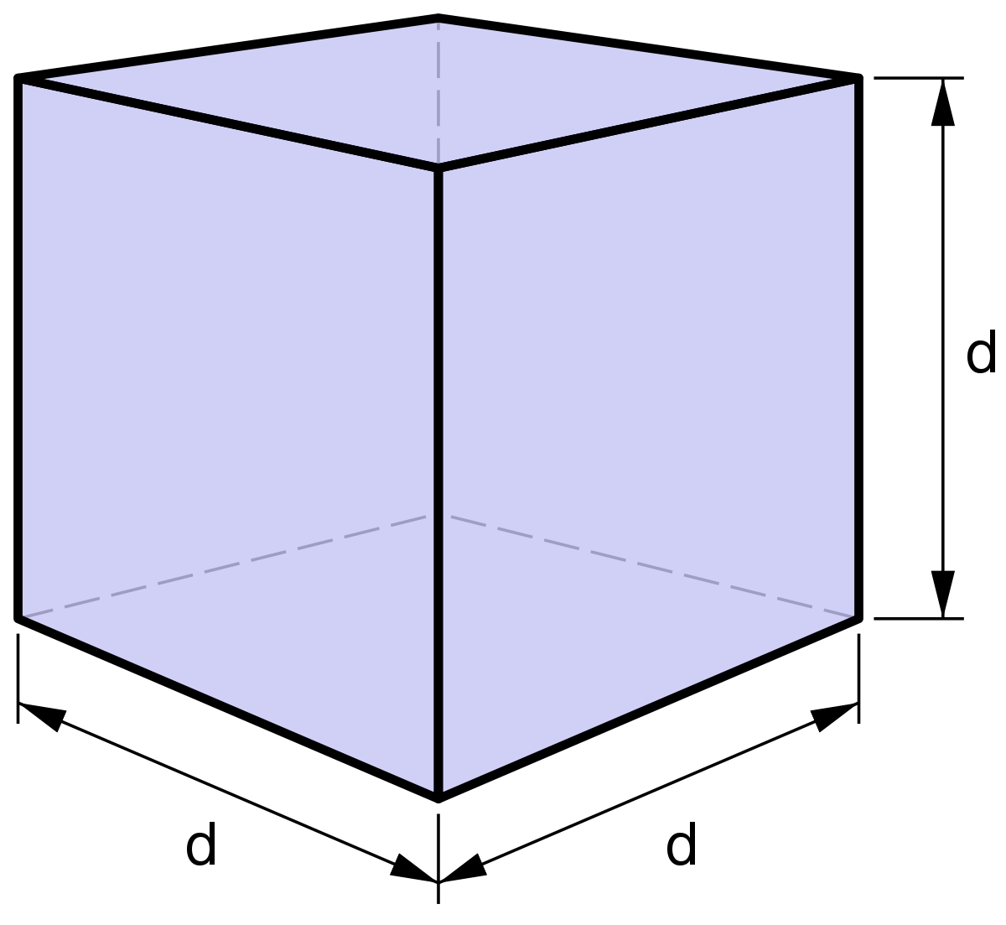
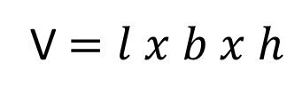
Possible solution
The volume of a shape is 216, what can it be?
(Adapted from Boaler, 1998).
Cube??
4
9
6
V $=l x b x h$

Slide 22
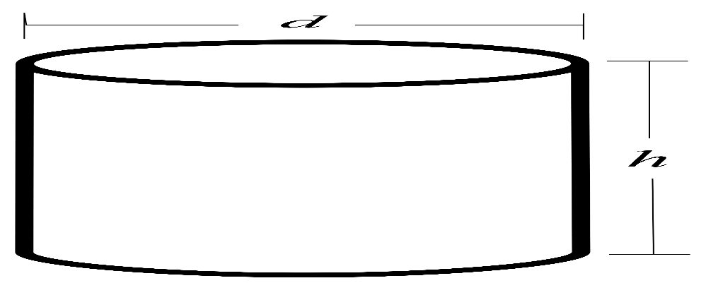
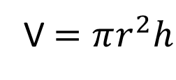
Possible solution
The volume of a shape is 216, what can it be?
(Adapted from Boaler, 1998).
Cylinder?
8
4.3
V $=πr^{2}h$

Slide 23
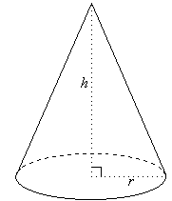
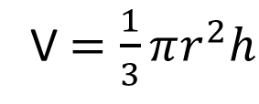
Possible solution
The volume of a shape is 216, what can it be?
(Adapted from Boaler, 1998).
Cone?
12.9
4
V $=\frac{1}{3}πr^{2}h$

Slide 24
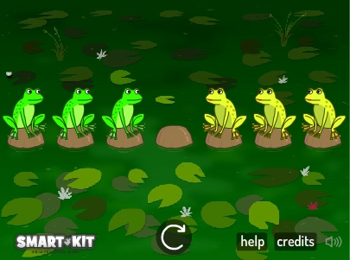
Problem 10
Two different families of frogs want to move over to the opposite side of the pond (i.e. the green frogs want to get to the right hand side and the yellow frogs want to move to the left hand side).
Frogs can jump over each other onto an empty stone or they can slide onto an empty stone which is immediately in front of them. Only one frog is allowed on each stone at a time and they cannot move backwards.
The challenge is to do this in as few slides and jumps as possible.

Slide 25
Problem 10
The challenge is to do this in as few moves as possible. Each individual slide and jump counts as one move.
Begin with one frog on both sides and record the number of moves taken. Once you have this done, see if you can do it for a different number of frogs.
Can you find a rule that predicts how many moves a given number of frogs will take?
https://nrich.maths.org/1246

Slide 26
Possible solution
Record your results in a table…
Number of Frogs on each side | Number of Moves
1
2
3
4
5
…….
n

Slide 27
Possible solution
Number of Frogs on each side | Number of Moves
1 | 3
2
3
4
5
…….
n

Slide 28
Possible solution
Number of Frogs on each side | Number of Moves
1 | 3
2 | 8
3
4
5
…….
n

Slide 29
Possible solution
Number of Frogs on each side | Number of Moves
1 | 3
2 | 8
3 | 15
4
5
…….
n

Slide 30
Possible solution
Number of Frogs on each side | Number of Moves
1 | 3
2 | 8
3 | 15
4 | 24
5 | 35
…….
n | ?
Can you find a rule that predicts how many moves a given number of frogs will take?

Slide 31

Possible solution
Number of Frogs on each side (F) | Multiplier | Number of Moves (M)
1 | x (3) | 3
2 | x (4) | 8
3 | x (5) | 15
4 |  | 24
5 |  | 35
…….
n |  | ?
$$M=F(F+2)$$
Can you find a rule that predicts how many moves a given number of frogs will take?

Slide 32

Possible solution
Number of Frogs on each side (F) | Multiplier | Number of Moves (M)
1 | x (3) | 3
2 | x (4) | 8
3 | x (5) | 15
4 |  | 24
5 |  | 35
…….
n |  | ?
$$M={(F+1)}^{2}−1$$
Can you find a rule that predicts how many moves a given number of frogs will take?

Slide 33
Extra problem 11
How many squares can you make using any four points from the grid below as corners?

Slide 34
Possible solution
Size 1
9 squares

Slide 35
Possible solution
Size 2
4 squares

Slide 36
Possible solution
Size 3
1 square

Slide 37
Possible solution
Also diagonals…
2 squares

Slide 38
Possible solution
Also diagonals….
4 squares

Slide 39
Extra problem 11
How many squares can you make using any four points from the grid below as corners?
20 squares

Slide 40
Extra problem 12
How many equilateral triangles can you make using any three points from the grid below as corners?
None!

Slide 41
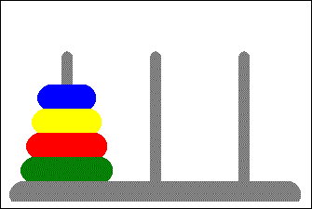
Extra problem 13
In this problem we have a set of n disks all of different sizes, and we have three pegs. All of the disks are on the first peg, and they are in order of size with the largest disk on the bottom. The goal is to move all the disks from the first peg to the third peg, moving only one disk at a time. There is only one catch. You can never put a larger one on top of a smaller one. Can you find a rule that predicts the minimum number of moves a given number disks will take?
http://www.softschools.com/games/logic_games/tower_of_hanoi/

Slide 42

Possible solution
Number of disks (n) | Number of Moves (M)
1 | 1
2 | 3
3 | 7
4 | 15
5 | 31
…….
n | ?
$$M=2^{n}−1$$

Slide 43
Extra…problem 14
Albert and Bernard just became friends with Cheryl, and they want to know when her birthday is. Cheryl gives them a list of 10 possible dates: May 15, May 16, May 19, June 17, June 18, July 14, July 16, August 14, August 15, August 17.
Cheryl then tells Albert and Bernard separately the month and the day of her birthday, respectively.
Albert: I don’t know when Cheryl’s birthday is, but I know that Bernard does not know too.
Bernard: At first I didn’t know when Cheryl’s birthday is, but I know now.
Albert: Then I also know when Cheryl’s birthday is.
So when is Cheryl’s birthday?

Slide 44
Possible solution
Albert knows the month and Bernard knows the date.
Months | Dates
May |  | 15 | 16 |  |  | 19
June |  |  |  | 17 | 18
July | 14 |  | 16
August | 14 | 15 |  | 17
Albert: I don’t know when Cheryl’s birthday is, but I know that Bernard does not know too.
If the birthday is in May or June, Bernard could know because the two dates that occur once are in these months. The fact that Albert states he knows Bernard does not know, means that the months have to be either July or August.

Slide 45
Possible solution
Albert knows the month and Bernard knows the date.
Months | Dates
July | 14 |  | 16
August | 14 | 15 |  | 17
Bernard: At first I didn’t know when Cheryl’s birthday is, but I know now.
The fact that Bernard now knows means that the 14th is eliminated as it is the only date which appears twice.

Slide 46
Possible solution
Albert knows the month and Bernard knows the date
Months | Dates
July |  |  | 16
August |  | 15 |  | 17
Albert: Then I also know when Cheryl’s birthday is.
The fact that Albert now knows means that the birthday must be in July because if it was August, Albert would still not know.
Therefore Cheryl's birthday has to be July 16th!!
https://www.khanacademy.org/math/math-for-fun-and-glory/puzzles/brain-teasers/v/cheryls-birthday

Slide 47
Extra…problem 15
In a long hall of the Arts Block, there are 100 lockers numbered 1 to 100. In preparation for the beginning of term, the custodian cleans the lockers, resets the combinations, and closes the locker doors. When the students return from summer vacation, they decide to celebrate the beginning of the college term by working off some energy. Student 1 runs down the row of lockers and opens every door. Student 2 closes the doors of lockers 2, 4, 6, 8, and so on to the end of the line. Student 3 changes the state of the doors of lockers 3, 6, 9, 12, and so on to the end of the line. (This means the student opens the door if it is closed and closes the door if it is open.) Student 4 changes the state of the doors of lockers 4, 8, 12, 16, and so on. This continues until every student has had a turn. When all 100 students have finished, which locker doors are open?

Slide 48
The locker problem
https://www.youtube.com/watch?v=WdL1EBNZvQ4

Slide 49
Before students arrived, the lockers were all closed.

Slide 50
Student 1 opened all the lockers.

Slide 51
Student 2 closed every second locker, starting from locker 2.

Slide 52
Student 5 changed the state of every fifth locker, starting at locker 5.

Slide 53
This is the state of the lockers after all twenty students opened and closed lockers.

Slide 54
Extension questions
If there were 500 students and lockers, which lockers remain open after the 500th student has passed?
Which lockers were touched by only two students? How do you know?
Which students touched both lockers 36 and 48?
Which lockers were switched the most times?

Slide 55

Notes:
Poll Title: One thing i have learned today.....
https://www.polleverywhere.com/free_text_polls/caF2Vsf0SnNZEYV

