Slide 1
Problem solving approaches
Session 1 – theory and practice

Slide 2
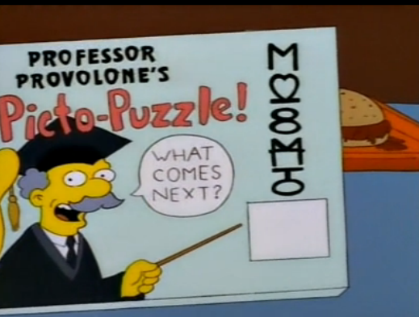
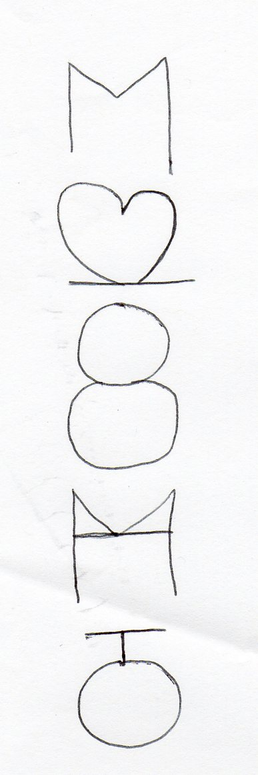
Warm up!
https://www.youtube.com/watch?v=VLf76wRTDzI
Notes:
Mirror/line symmetry – reflected image

Slide 3
Background of problem solving
In recent years many countries have been implementing comprehensive reform and are prioritising the development of problem solving in mathematics curricula (Guven & Cabakcor, 2013; OECD, 2009; QCA, 2008; Soh, 2008).
Lester and Lambdin (2004) believe that problem solving is one of the primary goals of mathematics learning.
It is the duty of all teachers and of teachers of mathematics in particular, to expose their students to problems much more than to facts (Halmos, 1980, p.523).
Notes:
Turkey, England, Scotland and Singapore

Slide 4
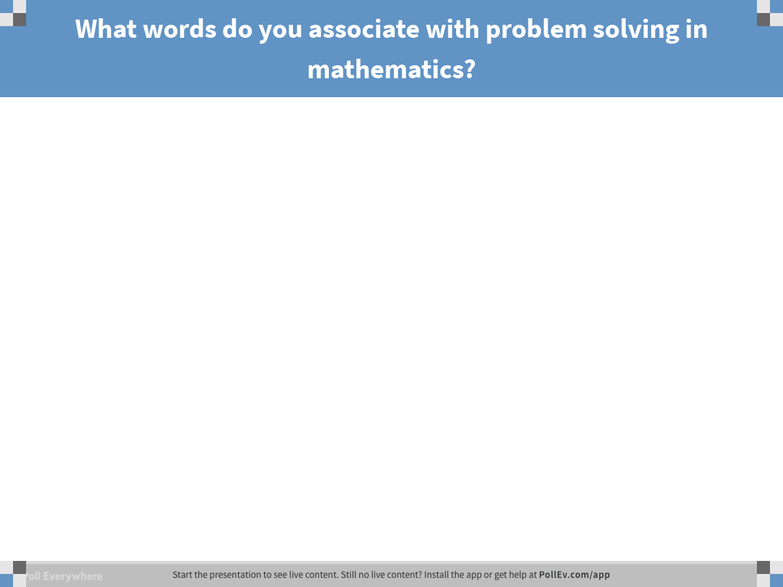
Notes:
Poll Title: What words do you associate with problem solving in mathematics?
https://www.polleverywhere.com/free_text_polls/70xxuHcGFL75KXl

Slide 5
What is problem solving?
“A problem is only a problem if you don’t know how to go about solving it. A problem that can be solved comfortably by routine or familiar procedures is an exercise.” (Schoenfeld, 1983).

Slide 6
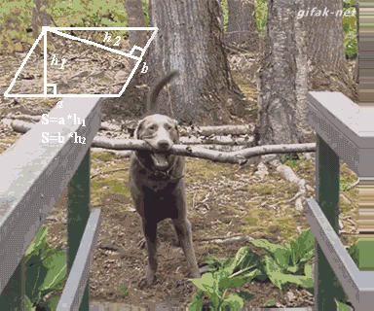
You are engaged in problem solving when you are trying to achieve something, and you do not know a straightforward way to do so.

Slide 7

Opening challenge….
Connect these nine dots with only four straight lines without lifting your pencil from the paper.

Slide 8
Extension challenge…
Divide these nine dots using three squares so that each dot is in its own section (the lines do not go through / touch the dots).

Slide 9
Why is problem solving important?
For students it…
Is a way to learn new mathematics.
Is a way to practise mathematics skills.
Is an insight into the work of mathematicians.
Builds confidence and produces positive attitudes.
Builds enquiry and reasoning skills.
Encourages co-operative and communicative skills.
Is enjoyable.

Slide 10
Why is problem solving important?

Slide 11
Why is problem solving important?
It gives students a taste for making knowledge rather than just receiving it (Neyland, 1995).
Students acquire ways of thinking and habits of persistence and curiosity that serve them well outside the mathematics classroom (NCCA, 2005).
Mathematical knowledge and skills have little value if they cannot be applied to new or unfamiliar situations (Ubuz, 1994: 367).

Slide 12

Why is problem solving important?
1,128 soldiers need to be bused to their training site. Each bus can hold 36 soldiers. How many buses are needed to transfer all of the soldiers? (Carpenter, Lindquist, Matthews, & Silver, 1983).
29% answered 31 remainder 12
23% answered 32

Slide 13
Problems with problem solving
Lack of time and patience in solving problems.
“When given a novel task in maths class, students are very likely to jump into the problem with one strategy, continue the strategy without ‘looking back’ and finish without re-examining the solution…Often the result can be a misunderstood problem, or an ineffective strategy, and/or a solution that does not work.”
(Goldberg & Bush, 2003)

Slide 14
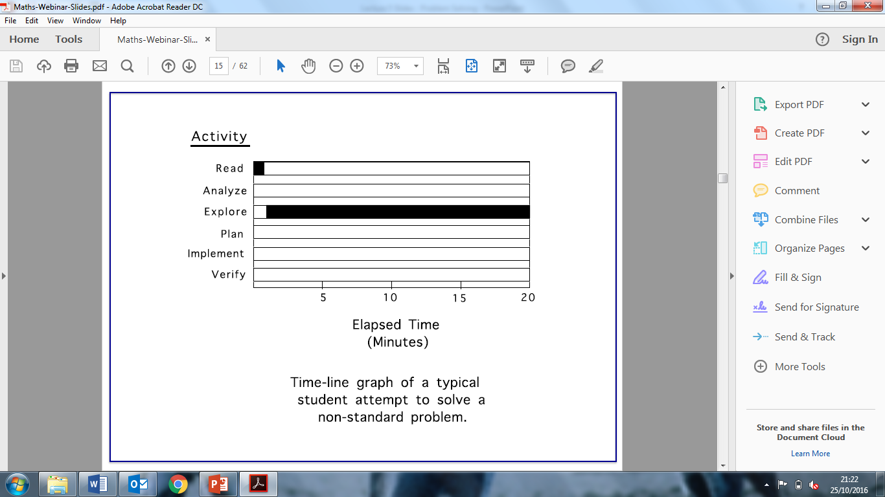
Problems with problem solving
(Schoenfeld, 2017)

Slide 15
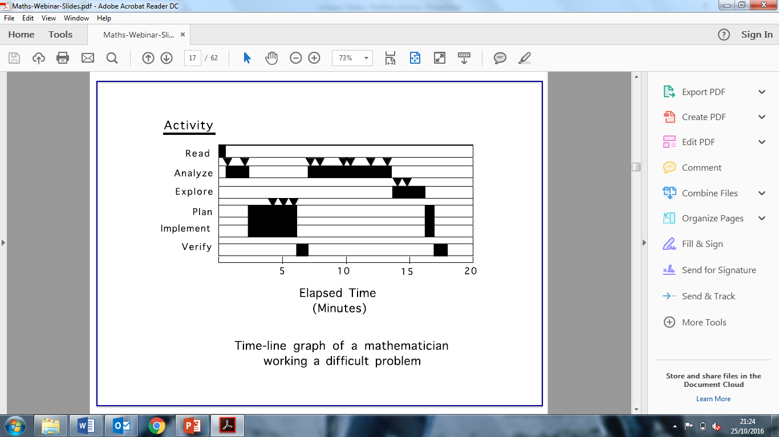
Problems with problem solving
(Schoenfeld, 2017)

Slide 16
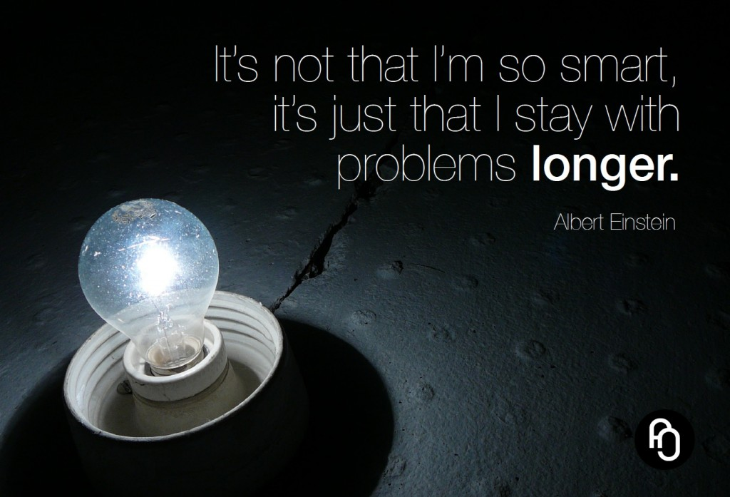
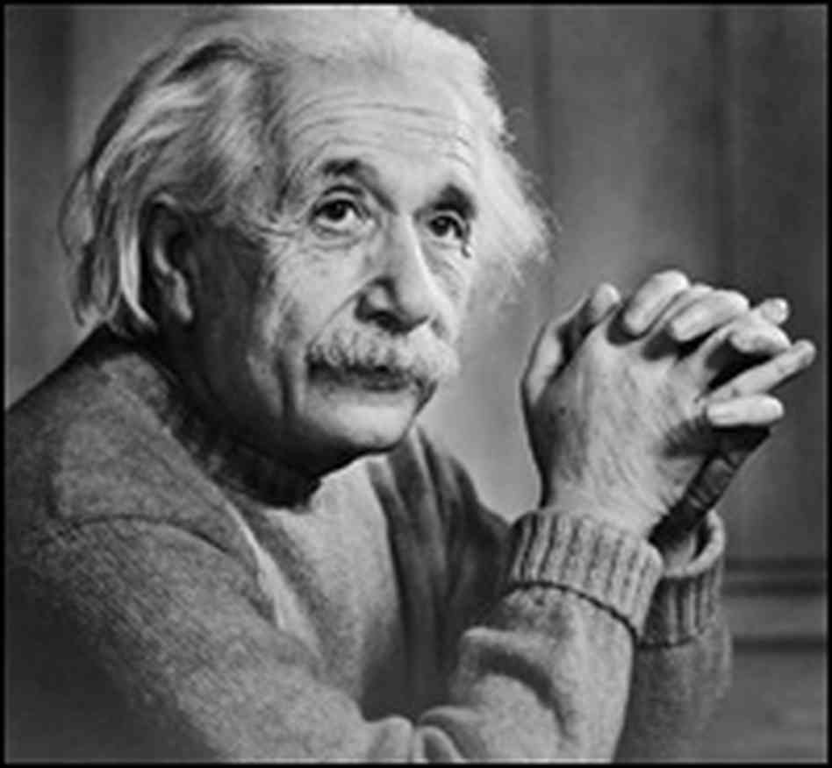
Patient problem solving
http://www.youtube.com/watch?v=BlvKWEvKSi8

Slide 17
The linear model to problem solving
The models used in numerous textbooks do not promote an accurate picture of the true spirit of problem solving.
1. They present problem solving as a series of steps.
2. They imply that solving mathematics problems is a procedure to be memorised and practiced.
3. They lead to an emphasis on getting an answer.

Slide 18
What constitutes a problem?
Ireland lower Secondary school ‘maths problem’ in 2008 State exam

Slide 19
Another example from 2008 exam…

Slide 20
Another example from 2008 exam…

Slide 21
Example since reformed curriculum

Slide 22
Characteristics of problem solving
May be more than one method. Justify / explain reasoning.
Should not be step by step linear process.
Models for problem solving should be cyclical in nature.

Slide 23
Polya’s 4 stages of problem solving
Stage 1 Understanding the problem
Stage 3 Carry out the plan
Stage 4 Look back/review
Stage 2 Devising a plan

Slide 24
Stage 1 – understanding the problem
What are you asked to find or show?
Can you restate the problem in your own words?
Visualise the problem? (https://www.youtube.com/watch?v=6Jq_9ghf-jI) Can you think of a picture or diagram that might help you understand the problem?
Is there enough information to enable you to find a solution? If so, what do you think is the critical information provided?

Slide 25
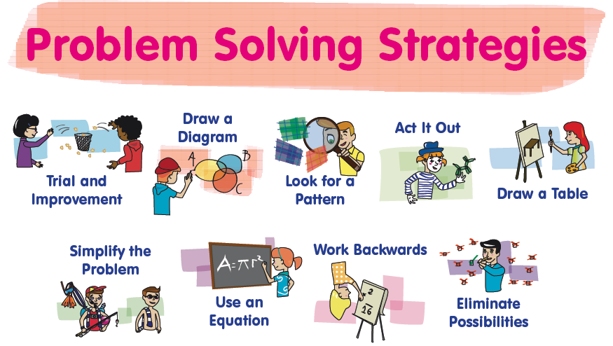
Stage 2 – devising a plan

Slide 26

Stage 3 – carrying out the plan
Monitor progress to make sure things go accordingly.
Check each step.
Record errors or special considerations for future review.
Try a new plan if this fails.

Slide 27
Stage 4 – looking back/review
Is there any method you could use that would allow you to verify your answer?
Does your answer make sense?
Can you interpret your answer in the context of the question?
Is there another method? Which method is more efficient?
What would happen if some condition/information changed?

Slide 28

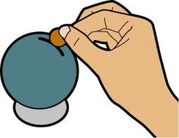
Problem 1
John has 18 ten-cent coins in his wallet and Owen has 22 five-cent coins in his wallet.
Each day, they decide to take one coin from their wallets and put it into a money box, until one of them has no more coins left in their wallet.
When does Owen have more money than John in his wallet?

Slide 29
Stages of problem solving
Stage 1 Understanding the problem
Stage 3 Carry out the Plan
Stage 4 Look back/Review
Stage 2 Devising a Plan

Slide 31
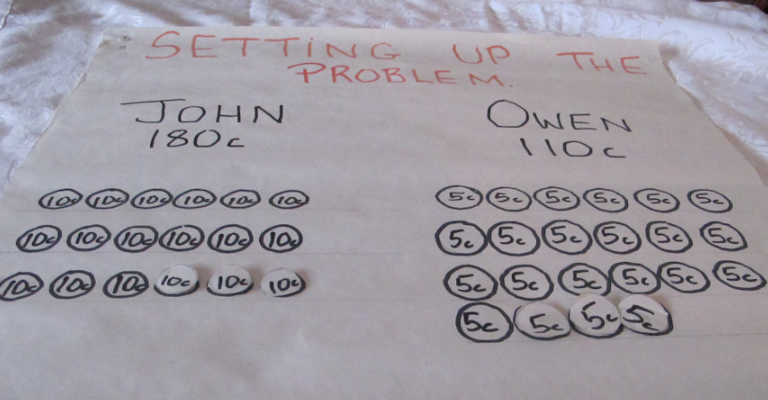
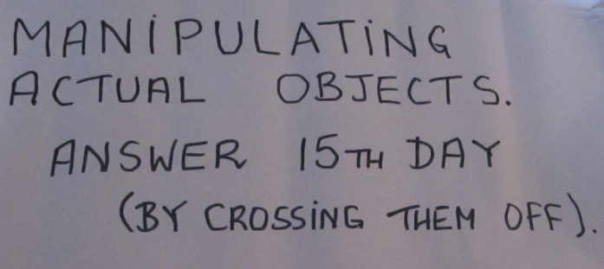
Acting it out

Slide 32
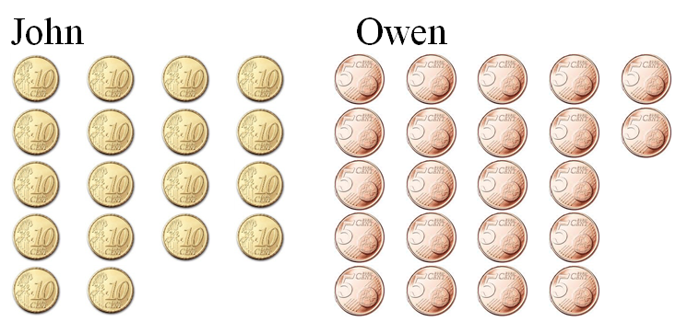

Making a table
Day | John | Owen
Start
180c
110c
Day 1
170c
105c
Day 2
160c
100c

Slide 33
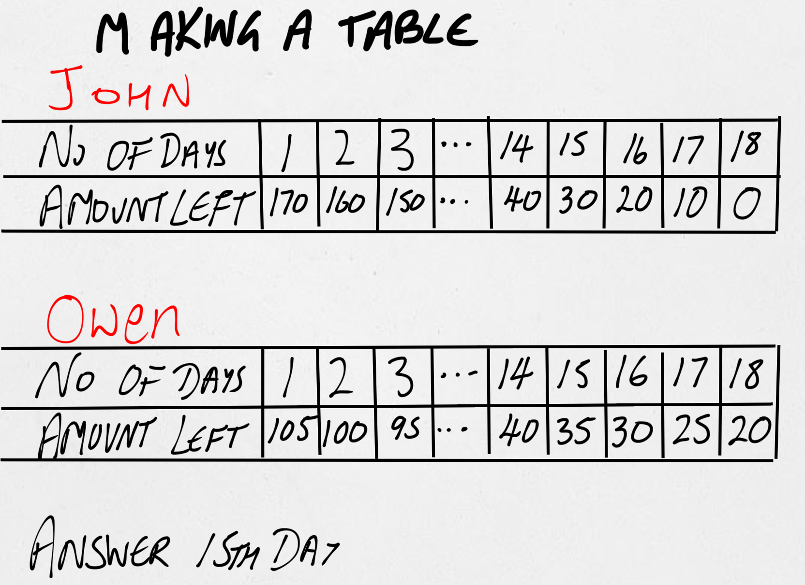

Slide 34
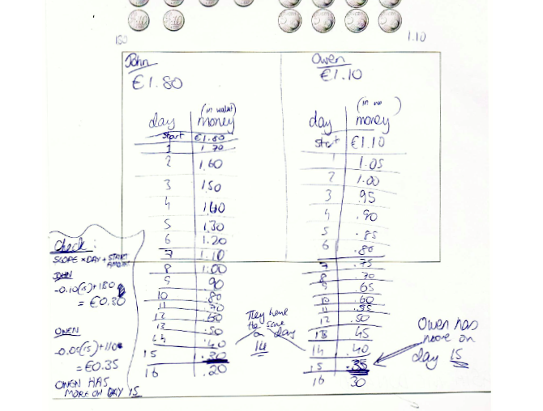

Slide 35
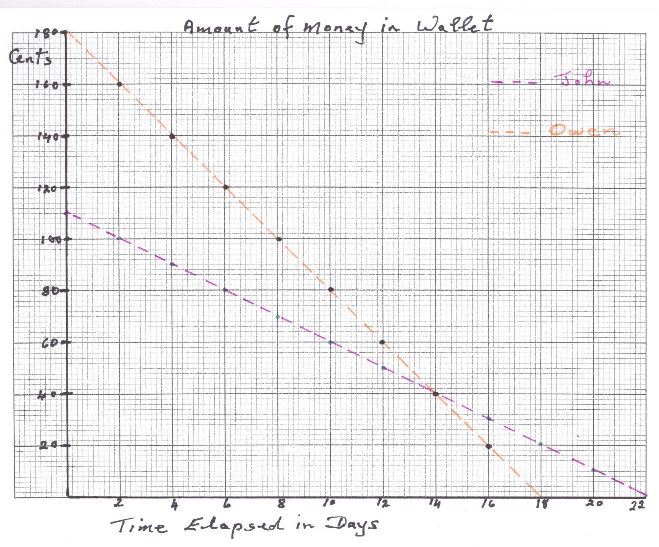
Representing on a graph

Slide 36
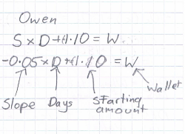
Constructing an equation

Slide 37
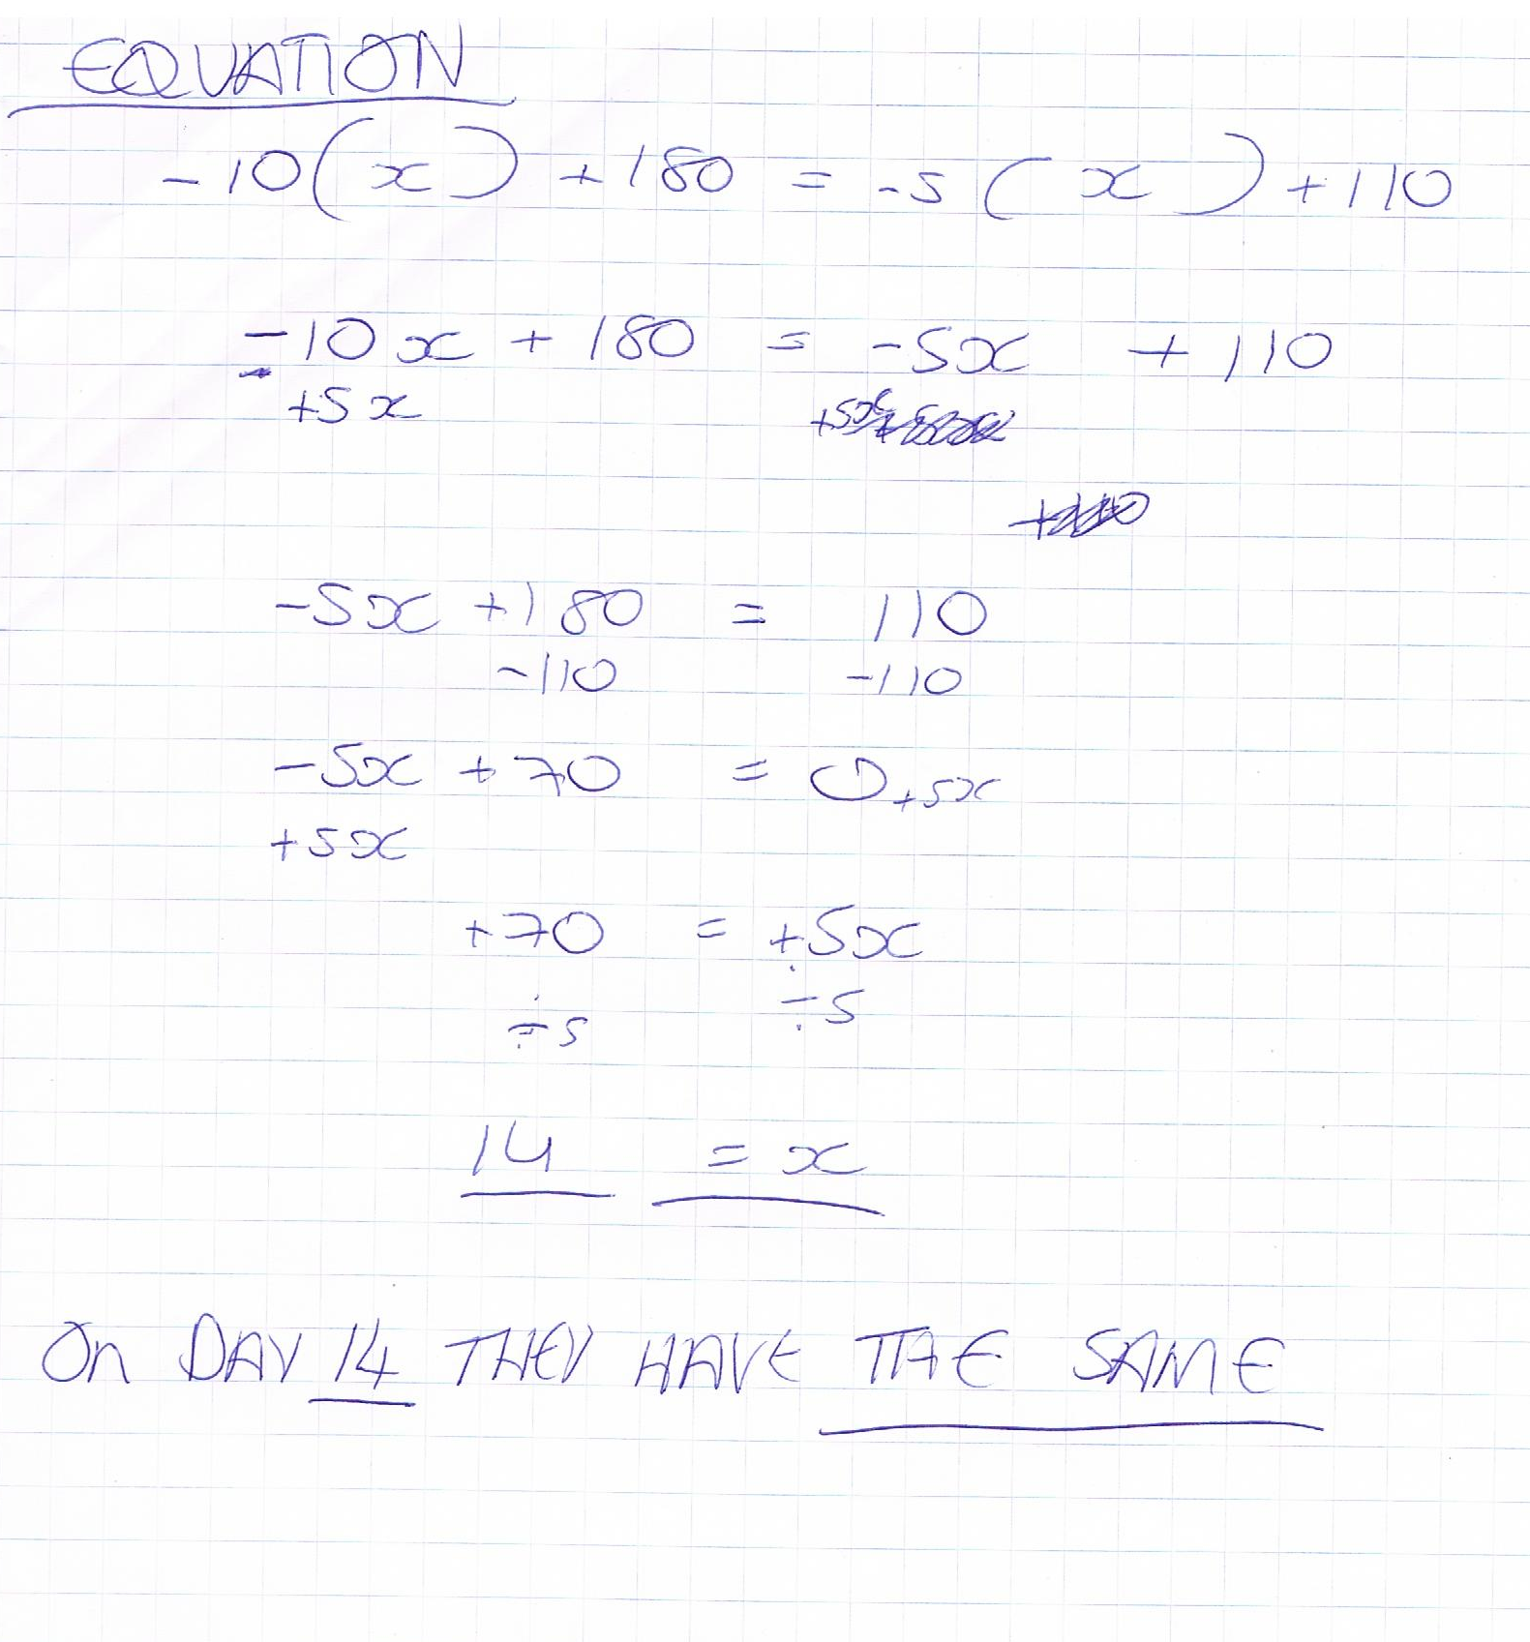
Constructing and solving an equation

Slide 38





Constructing and solving an inequality
$$Owen>John$$
$$110 −5 d>180 −10 d$$
$$110+5 d>180$$
$$5 d>70$$
$$d>14$$
Owen has more money than John after the 14th day, i.e. day 15.

Slide 39

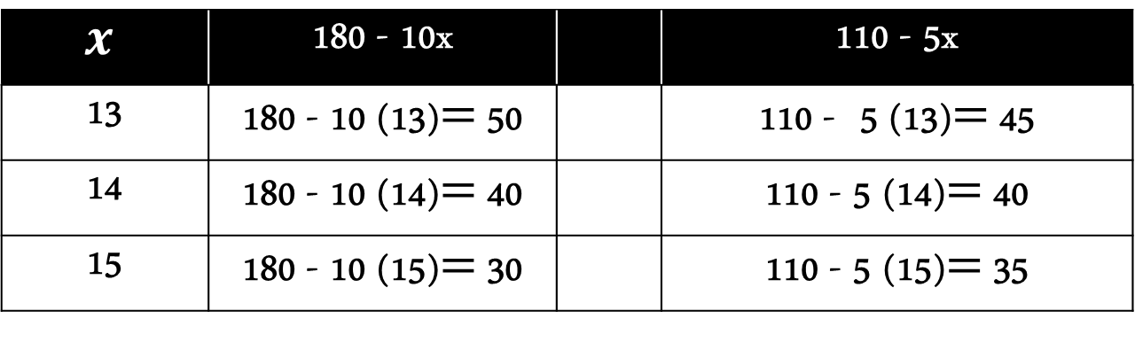



Table involving expressions & inequalities
John
Owen
$$x$$ | 180 - 10x |  | 110 - 5x
13 | 180 - 10 (13)$=$ 50 |  | 110 - 5 (13)$=$ 45
14 | 180 - 10 (14)$=$ 40 |  | 110 - 5 (14)$=$ 40
15 | 180 - 10 (15)$=$ 30 |  | 110 - 5 (15)$=$ 35
$$>$$
$$=$$
$$<$$

Slide 40

In problem solving there may always be...

Slide 41
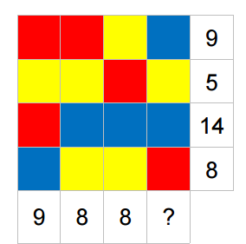
Problem 2
What is the missing number?

Slide 42
Solution A
3 yellows and 1 red
Yellows could be 1 and then red is 2
3 blues and 1 red
If red is 2, then blue is 12 ÷ 3 = 4
2 blues + 1 yellow + 1 red
2(4) + 1(1) + 1(2) = 11

Slide 43
Solution B
A set of equations, for example:

Slide 44
Solution C
? = 36 – 25
? = 11

Slide 45
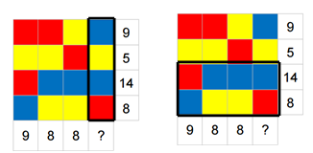
Solution D
22
11

Slide 46
Do we stifle creativity in school maths?
The previous problem was given to groups of Israeli students from different grades (Uziel & Amit, 2016).
There were 24 students aged 11-12 who solved the problem. 1 of those used algebra.
There were 31 students aged 17-18 who solved the problem. 25 of those used algebra.

Slide 47
What makes a successful problem solver?
“The processes involved in mathematical problem solving are affected by factors beyond simply the knowledge that a person holds.” (Mason, 2003).

Slide 48
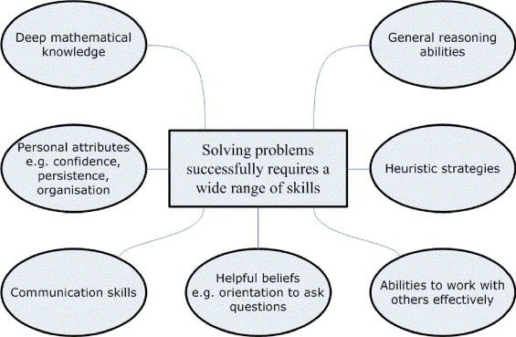
Factors contributing to successful problem solving
(Stacey, 2005)

Slide 49
Link between beliefs and problem solving
Mason and Scrivani (2004) determined that students’ beliefs affect the cognitive resources available to them.
Schoenfeld (1983) revealed that students negative beliefs towards mathematics can render certain stored knowledge inaccessible, thereby affecting their ability to use this knowledge to solve problems.

Slide 50
Students’ beliefs about problem solving
Those who understand the subject matter can solve assigned problems in 5 minutes or less.
Mathematics problems have only one right answer.
There is only one correct way to solve a mathematics problem – usually the rule the teacher has demonstrated most recently to the class (Schoenfeld, 1992).
There are always numbers in formulations of math problems (Callejo and Vila, 2009).

Slide 51
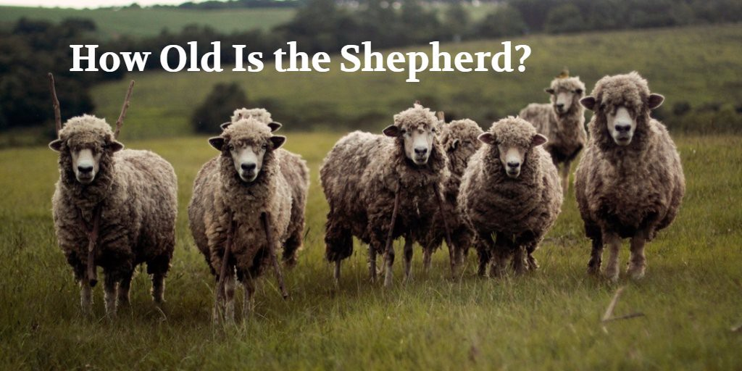
Students’ beliefs about problem solving
All word problems presented in the classroom can be solved (Schoenfeld, 1989).
There are 125 sheep and five dogs in a flock. How old is the shepherd? (Ruesser, 1988).
https://www.youtube.com/watch?v=kibaFBgaPx4

Slide 52
Challenging students’ beliefs
In a recent study Stylianides & Stylianides (2014) successfully challenged four common beliefs towards problem solving:
Problems can be solved in five minutes or less.
Perseverance is not necessary.
There are always formulations in math problems.
It is not a satisfying or enjoyable activity.
The problem they used in the study was the ‘Blond Hair’ problem.

Slide 53
Challenging students’ beliefs
The blonde hair problem
Two friends, John and Angela, meet after having not seen each other in many years. They have the following conversation…

Slide 54
John: Are you married? Do you have any children? How many? How old are they?
Angela: Yes, I am married. I have three children and the product of their ages is 36.
John: (After doing some thinking). I cannot figure out their ages. I don’t have enough clues.
Angela: Right! What if I told you that the sum of their ages is the number of your address?
John: (After doing some thinking again). I still can’t figure out their ages. I need one more hint.
Angela: I can also tell you that the oldest has blonde hair.
John: Aha! Now, I know the ages of your three children.
What are the ages of the children (ages can only be natural numbers)?

Slide 55
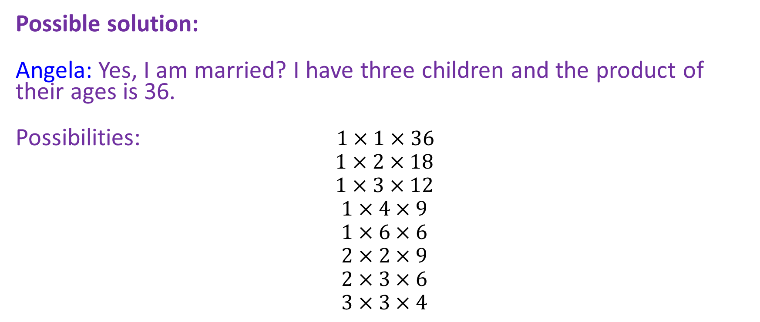
Possible solution:
Angela: Yes, I am married? I have three children and the product of their ages is 36.
Possibilities: $1×1×36$
$$1×2×18$$
$$1×3×12$$
$$1×4×9$$
$$1×6×6$$
$$2×2×9$$
$$2×3×6$$
$$3×3×4$$

Slide 56
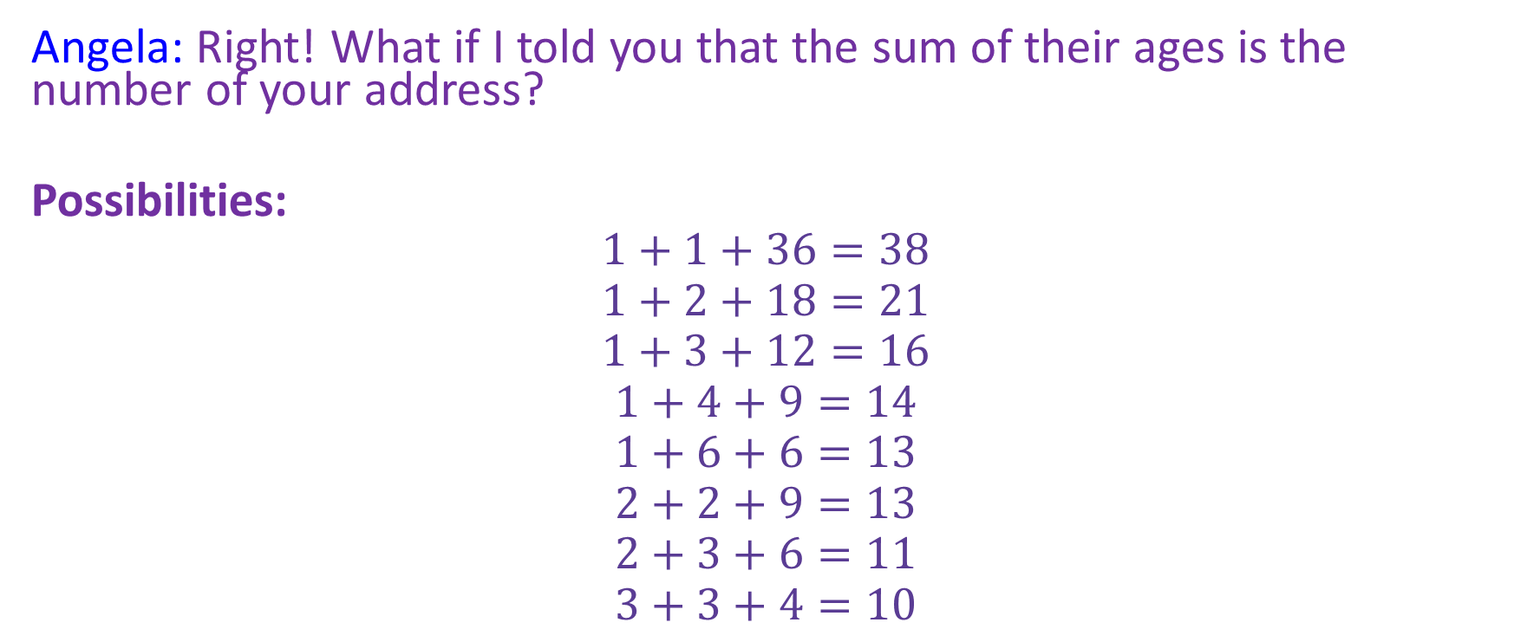
Angela: Right! What if I told you that the sum of their ages is the number of your address?
Possibilities:
$$1+1+36=38$$
$$1+2+18=21$$
$$1+3+12=16$$
$$1+4+9=14$$
$$1+6+6=13$$
$$2+2+9=13$$
$$2+3+6=11$$
$$3+3+4=10$$

Slide 57
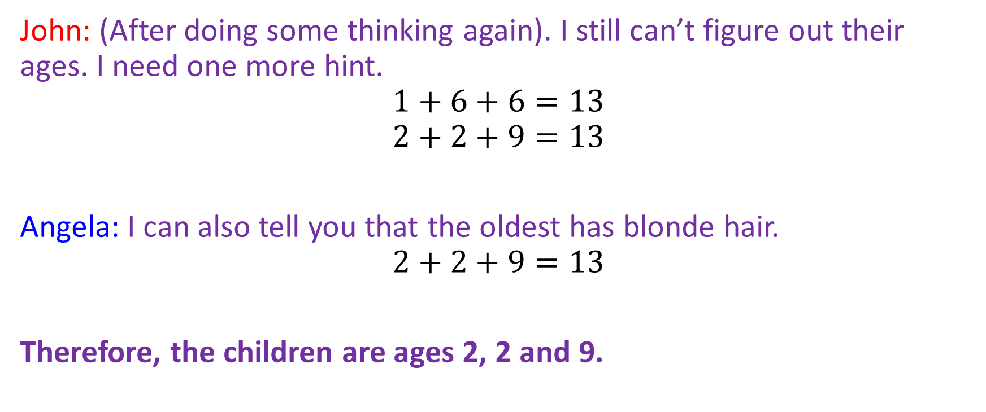
John: (After doing some thinking again). I still can’t figure out their ages. I need one more hint.
$$1+6+6=13$$
$$2+2+9=13$$
Angela: I can also tell you that the oldest has blonde hair.
$$2+2+9=13$$
Therefore, the children are ages 2, 2 and 9.

Slide 58
Conclusion
Problem solving sessions need to be structured by the teacher.
It takes time and trialling to set it up as an effective habit.
Encourage perseverance and patience!
Don’t tell them too much! Can be difficult for us!

