Slide 1
Using technology to develop problem solving activities

Slide 2
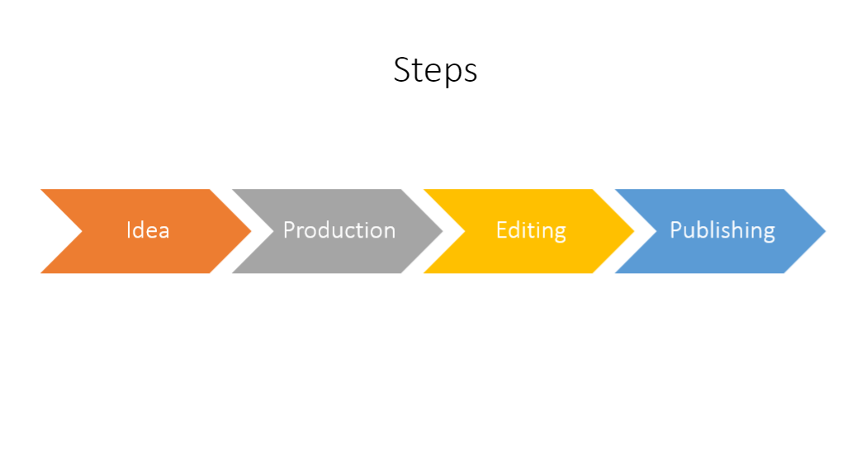

Slide 3
Without knowing your tools, it is
Hard to get innovative and creative

Slide 4
This is one example about how to make a structure. Everyone should refine their own.
The clearer the structure, the easier for audience to get onto it.

Slide 7
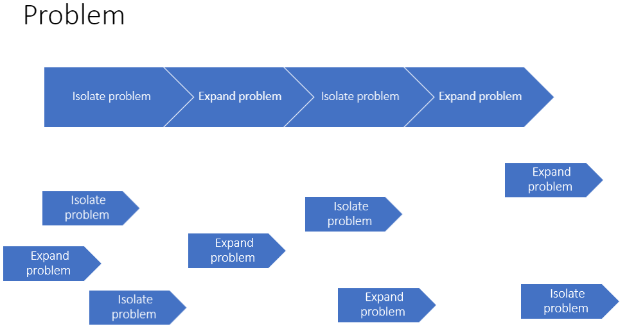

Slide 8
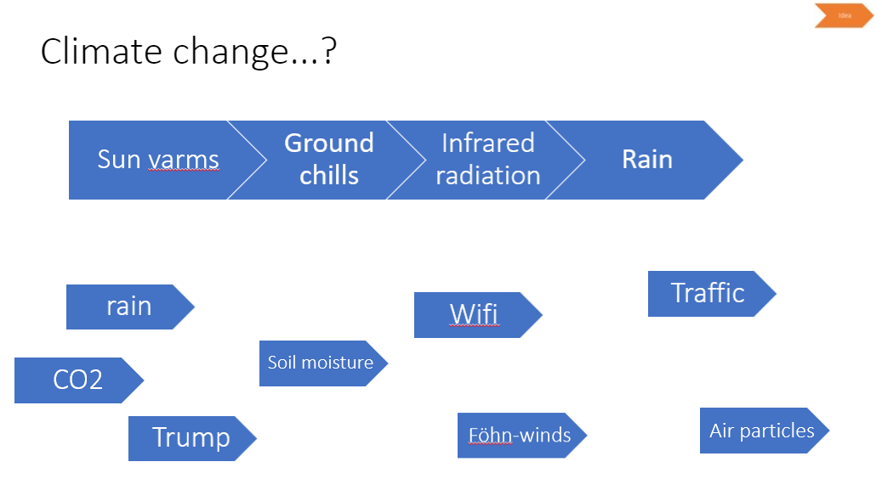

Slide 9
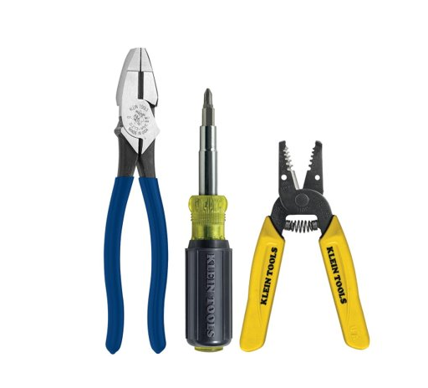

Slide 12
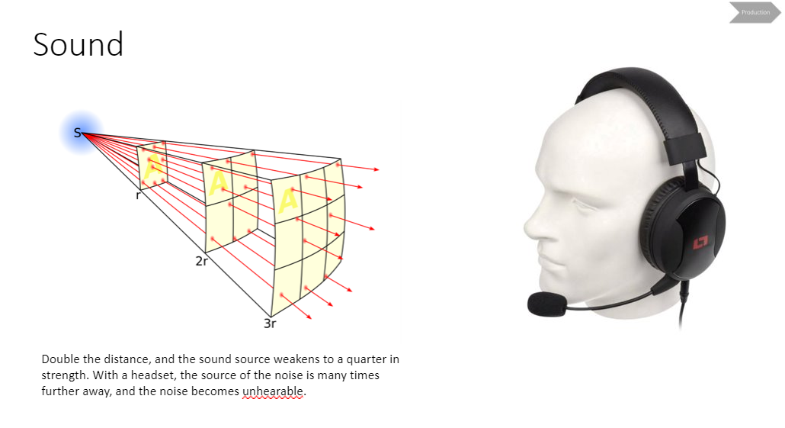

Slide 15
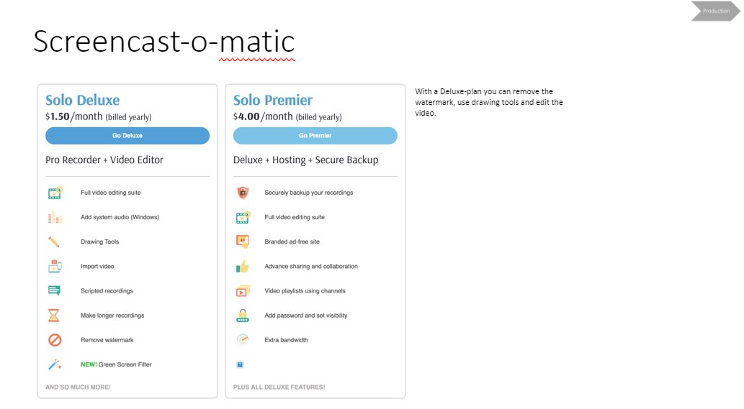
With a Deluxe-plan you can remove the
Watermark, use drawing tools and edit the video.

Slide 16
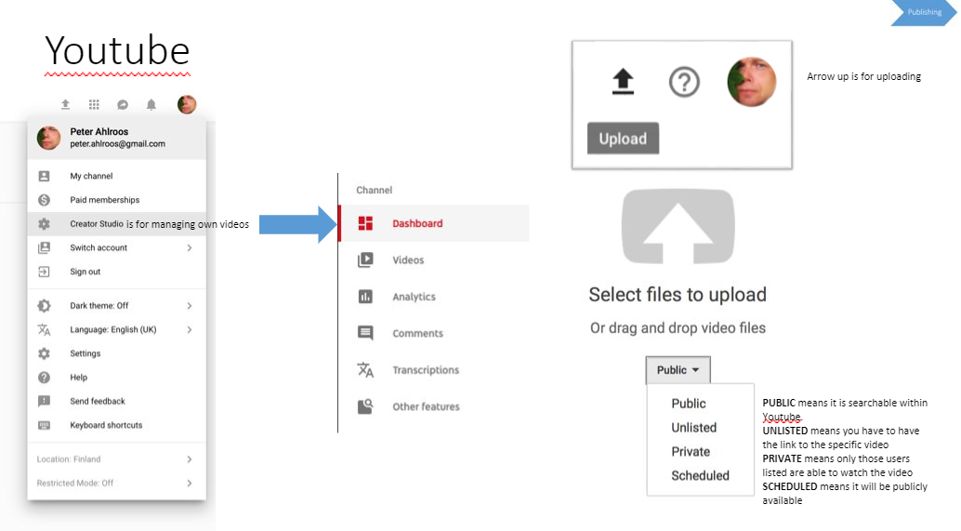

Slide 17
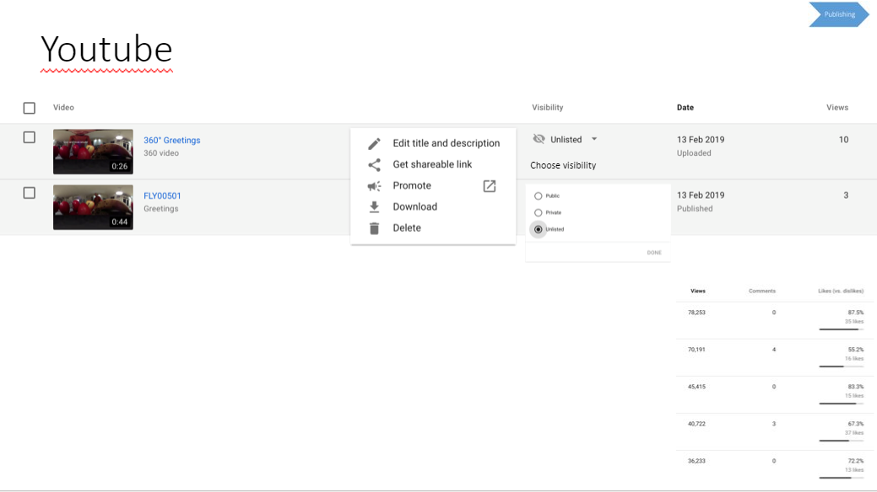

Slide 18
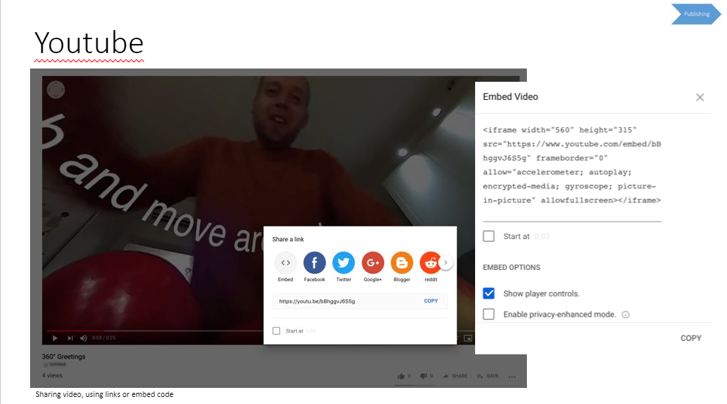

Slide 19
It is possible to get all kind of statistic, in addition
To amount of views, you can see how many has left
At a given time point.

Slide 20
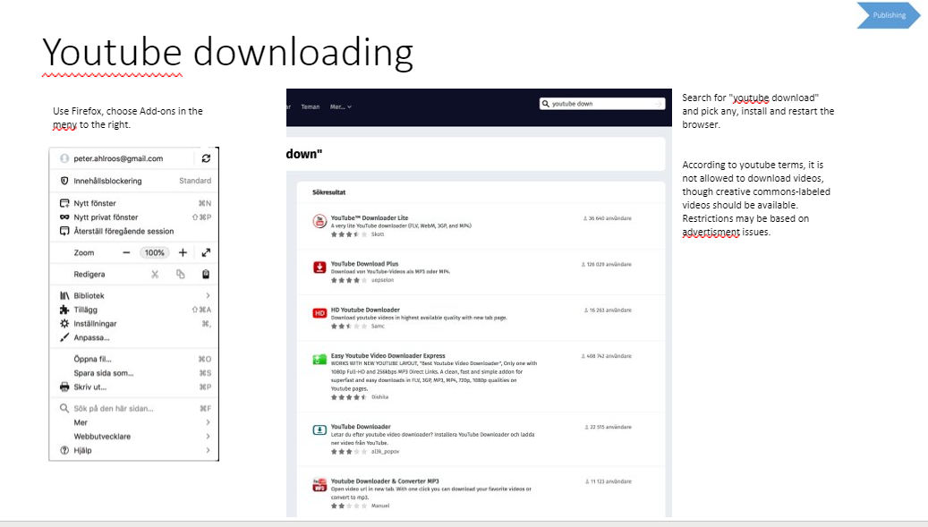

Slide 21
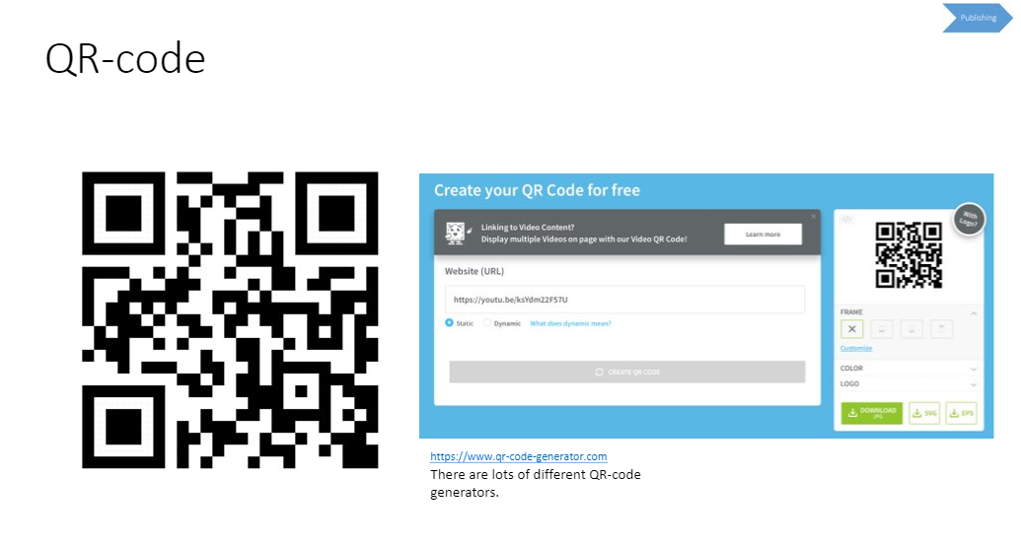

Slide 22
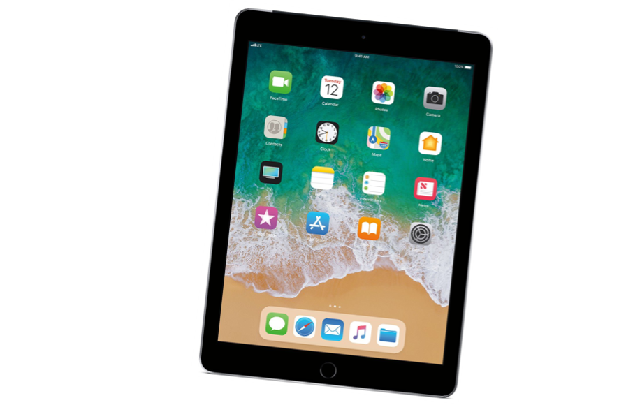

Slide 23
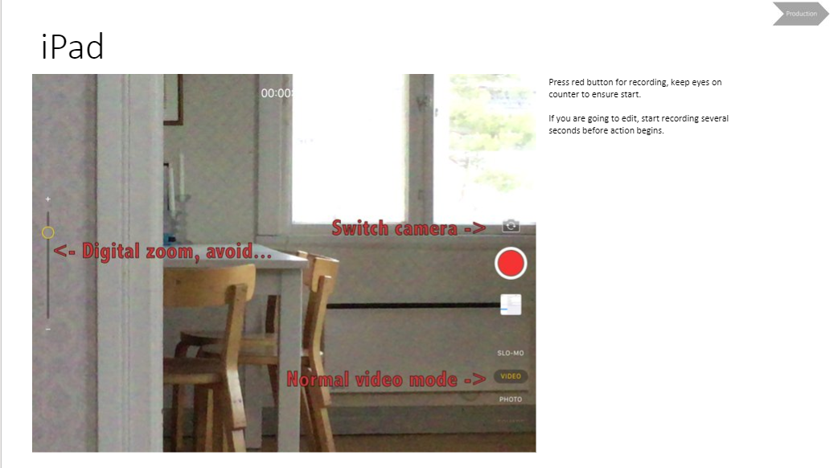

Slide 24
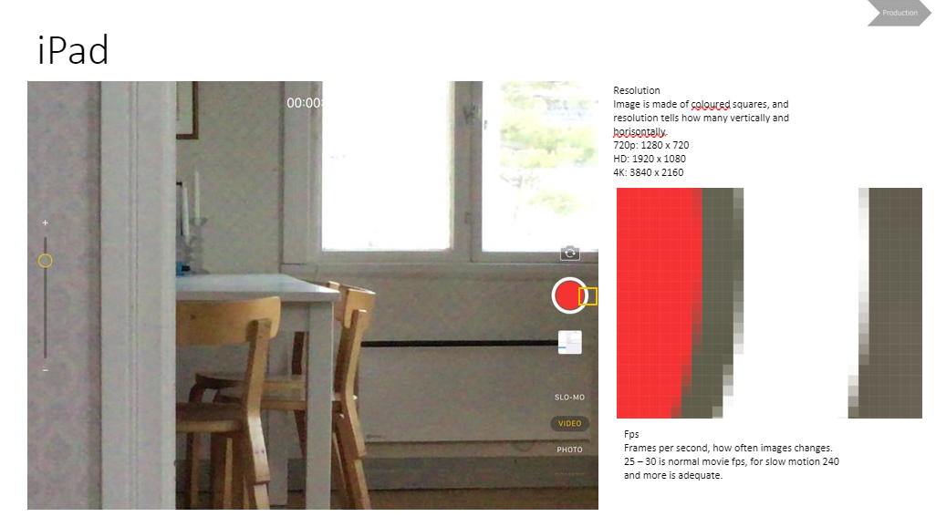

Slide 25
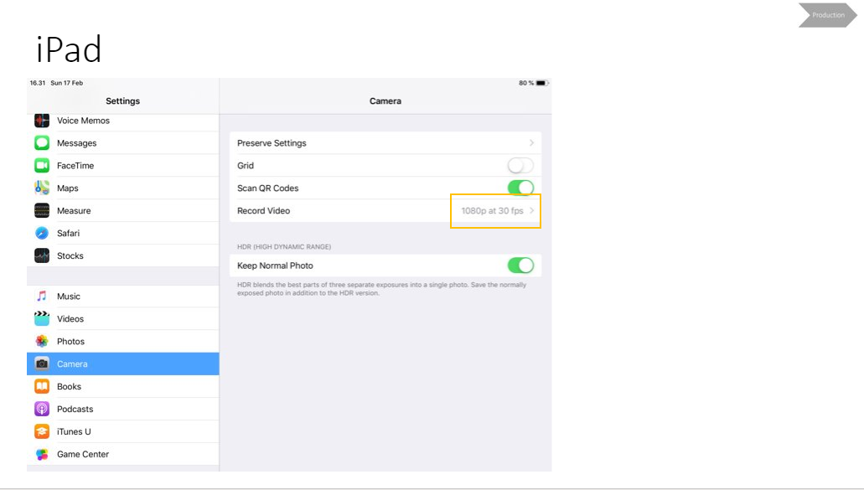

Slide 26
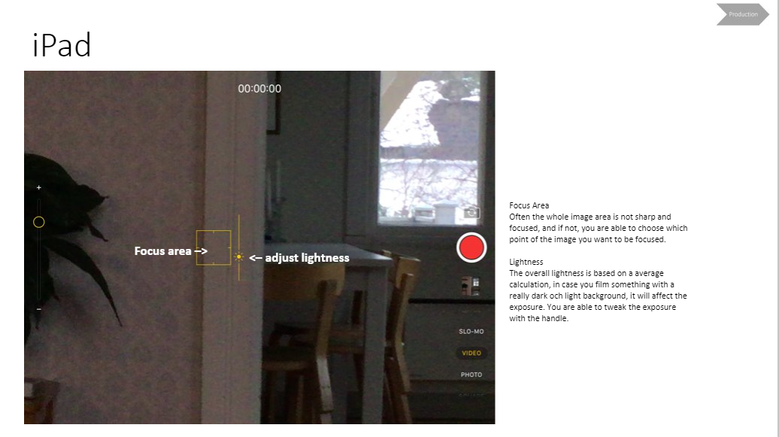

Slide 27
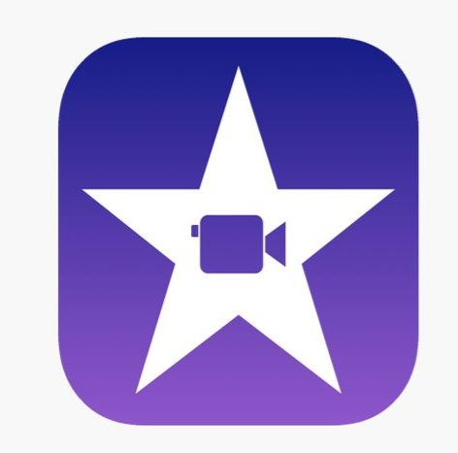

Slide 28
All projects are saved here, create a new one pressing
the plus-sign.
Choose Movie instead of Trailer

Slide 29
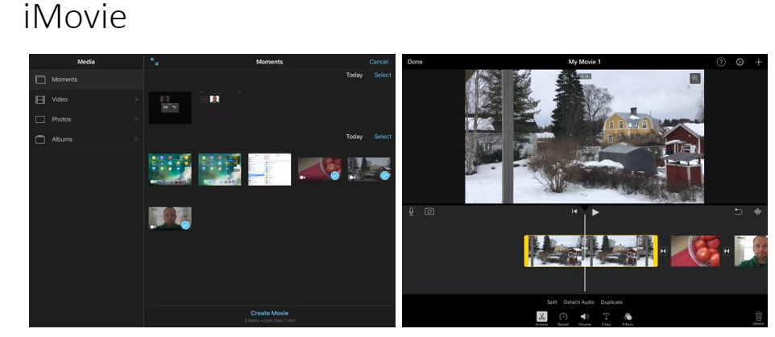
View all clips available on your iPad, select the ones
that you will use in your editing project.
Clips are automatically placed in order. Use yellow handles
to adjust the used portion of the clip. You can remove the transitions between the clips. You can split a clip, add text and adjust the volume.

Slide 30
The white vertical marker point out where you split the clip.

Slide 31
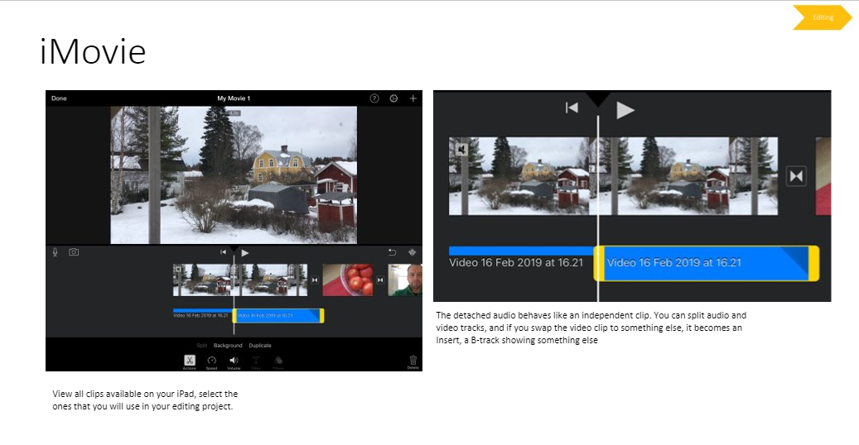
The detached audio behaves like an independent clip.
You can split audio and video tracks, and if you swap the video clip to something else, it becomes an insert, a B-track showing something else.
View all clips available on your iPad, select the ones
that you will use in your editing project.

Slide 33
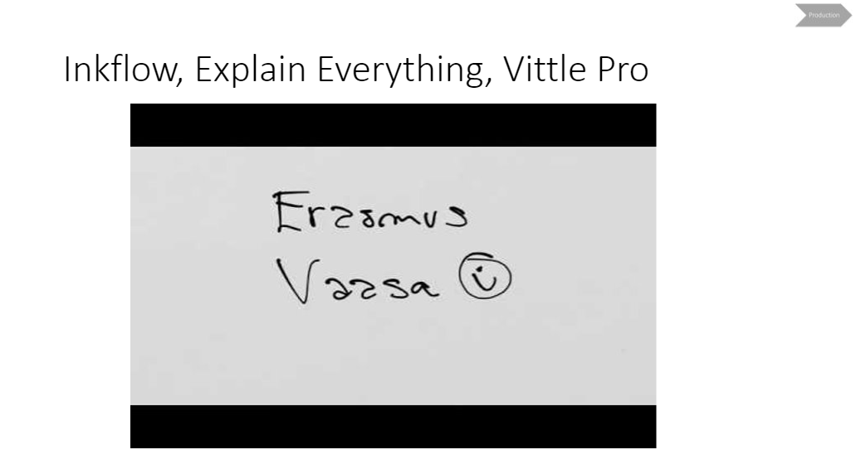

Slide 34
