Slide 1
Using GeoGebra to enrich problem solving
An introduction

Slide 2
Short presentation of the program
GeoGebra contents:
Geometry - construct, draw and investigate
Spreadsheet - data analysis and visualisation of data
CAS - computer algebra system - solve equations, investigate numbers etc.

Slide 3
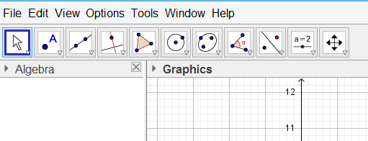
Geometry in GeoGebra
Presentation of the menu-bar and some icons

Slide 4
Geometry in GeoGebra
Open GeoGebra - write
geogebra.org

Slide 5
Geometry in GeoGebra
Try the tool polygon: When you draw, you have to click in
the graphics area. - First click marks the starting point - next click draws the next point and the line between the two points - click as many times as you want lines in your polygon and end clicking in your starting point.

Slide 6
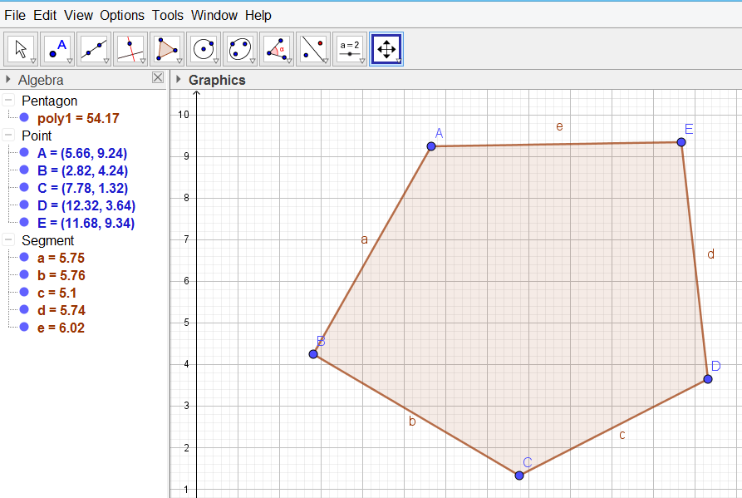
Example

Slide 7
Go ahead
Work in pairs and try to find out what you can do in GeoGebra
Write your findings in this Padlet:
kortlink.dk/ucfq

Slide 8
Collection of your findings
Any questions?
Any problems?

Slide 9
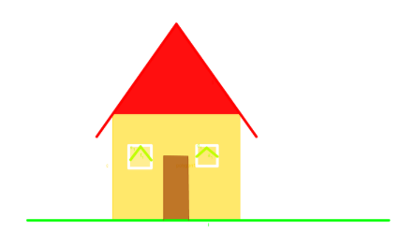
Draw a house
Draw a tree with branches
A chimney with smoke coming out
etc….

Slide 10
Draw a Flag

Slide 11
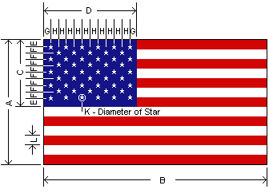
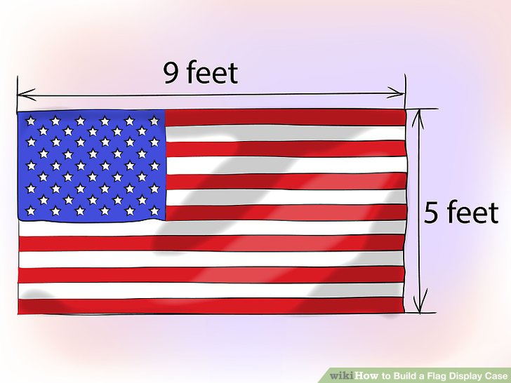
How to construct….
Search the internet:

Slide 12
work in pairs
kortlink.dk/ucs5

Slide 13
GeoGebra materials and more

Slide 14
Account in GeoGebra
You can use a google-account
or
another email address

Slide 15
Groups in GeoGebra
Write:
and you will join the group, where our materials are and new ones will arrive!
in

Slide 16
Work with photos in GeoGebra
You can use photos from this folder:
https://goo.gl/bNTxDf
or you can go and grab your own outside/inside

Slide 17
Investigations
Students learn more (and easier) when they get to experiment and investigate in maths - this is my opinion!
You are going to try it out!
Bungy jump with Barbie
Cars running
Dart
Ball jumping

Slide 18
Barbie and Cars
Here you can find the documents:
https://goo.gl/bNTxDf

Slide 19
Spreadsheet in GGb
GGb 5: Click on GGb 6: Click on

Slide 20
Note your observations
First:
Use pen and paper
Measure the first four jumps, then guess for jump #5 and #6

Slide 21
Slope of a function
GGb - geometric
Write y=ax+b in the input area
Say yes to sliders
Try to see what happens - discuss the potentials with your neighbour
Try with a squared function as well

Slide 22
Screencast
Screencast-o-matic - freeware
Make a screencast of one of your favourites from the three days here :-)

